Slide 1
LATE BINDESHWARI BAGHEL GOVERNMENT COLLEGE, KUMHARI, DIST. – DURG (C.G.)
College Website - http://gnckumhari.in/ Email Address – govtcollegekumhari@gmail.com
पोषक - विद्यालय संपर्क अभियान - 2024
STEP INTO EXCELLENCE: A JOURNEY OF STUDENTS AT LATE BINDESHWARI BAGHEL GOVERNMENT COLLEGE

Slide 2
College Website - http://gnckumhari.in
INTRODUCTION OF COLLEGE
NAME AND LOCATION
LATE BINDESHWARI BAGHEL GOVERNMENT COLLEGE KUMHARI, NEAR KUGDA RAILWAY CROSSING
YEAR OF ESTABLISHMENT
23/08/2021

Slide 3
College Website - http://gnckumhari.in
COURSES
All courses are under graduate level.
2. Multidisciplinary courses (NEP-2020).
B.A.
1.SOCIOLOGY
2.POLITICAL SCIENCE
3.ECONOMICS
B.Sc. (BIO)
1.BOTANY
2.CHEMISTRY
3.ZOOLOGY
B.Sc. (MATHS)
1.CHEMISTRY
2.MATHS
3.PHYSICS
B.Com.
ALL REQUIRED SUBJECTS

Slide 4
College Website - http://gnckumhari.in
FACULTY AND INFRASTRUCTURE

Slide 5
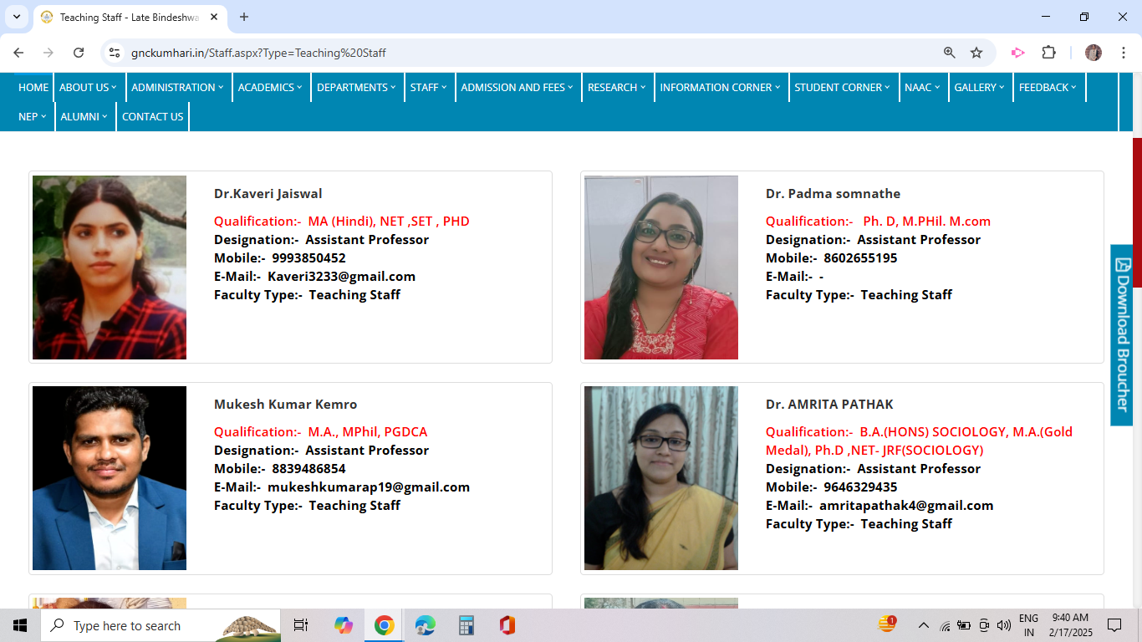
College Website - http://gnckumhari.in
QUALIFIED FACULTY MEMBERS

Slide 6
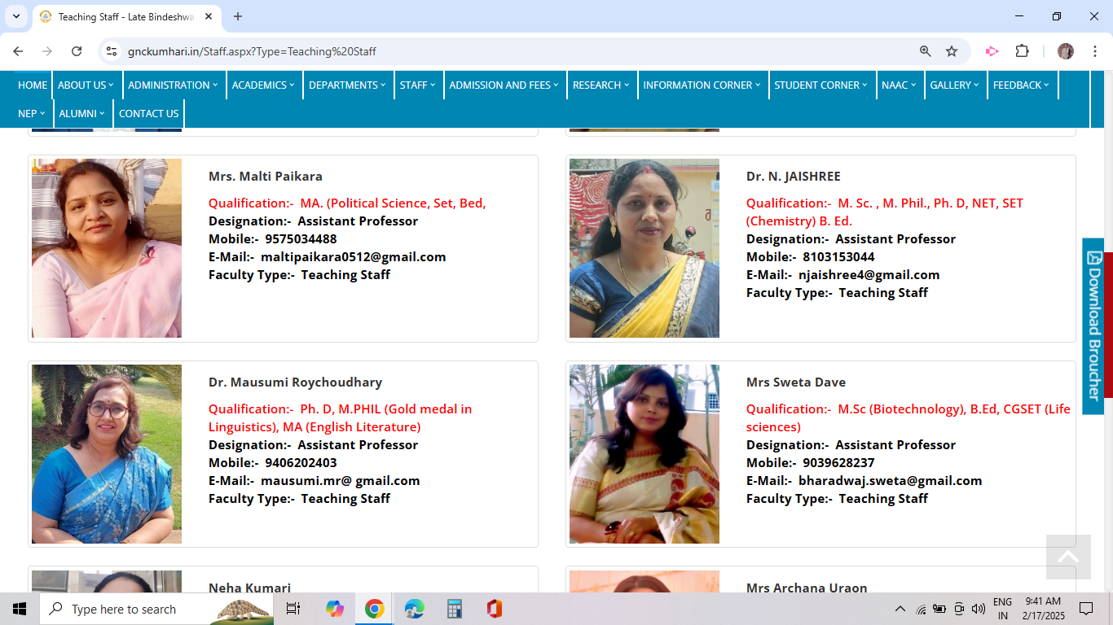
College Website - http://gnckumhari.in

Slide 7
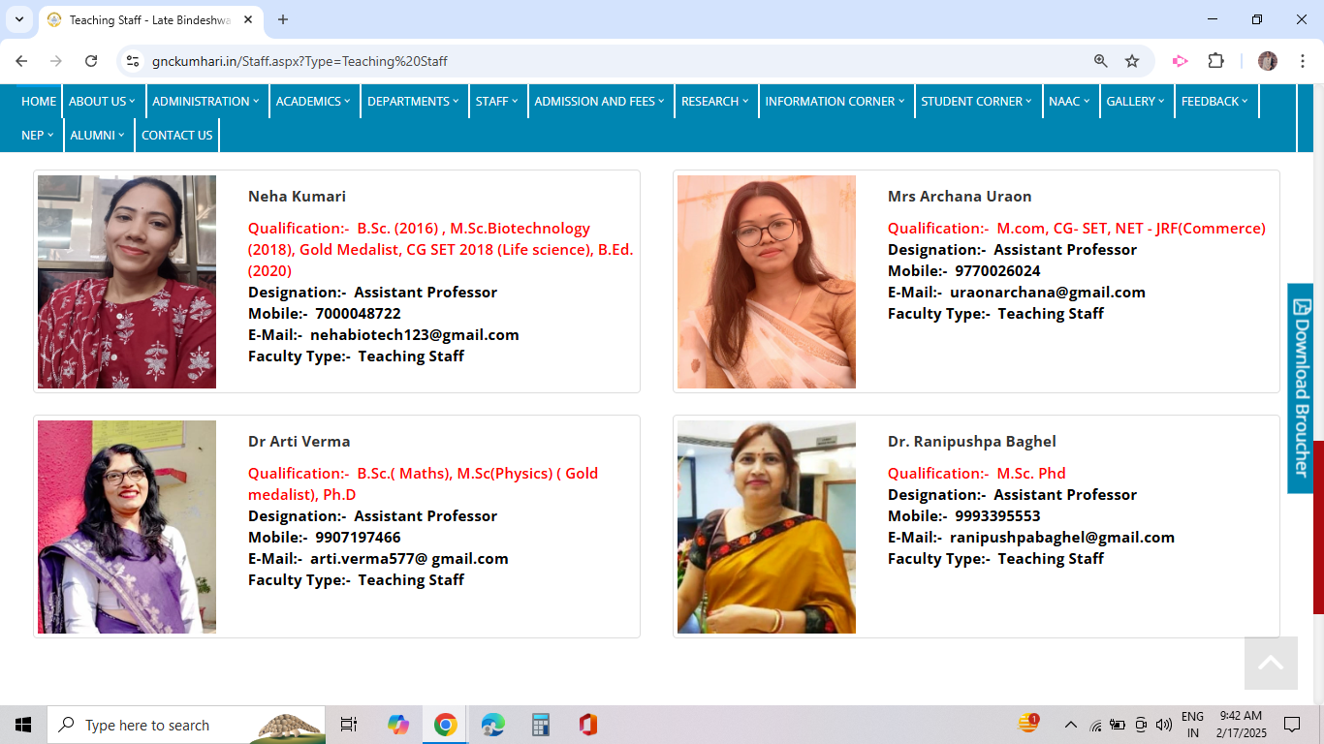
College Website - http://gnckumhari.in

Slide 8
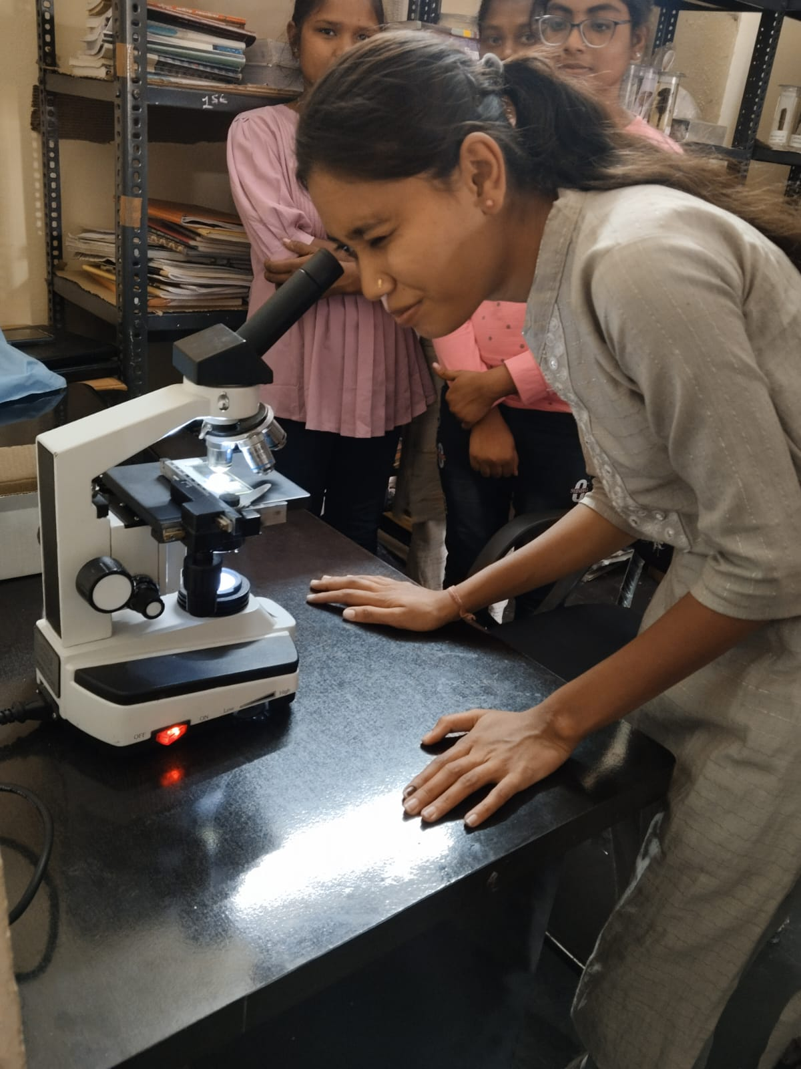
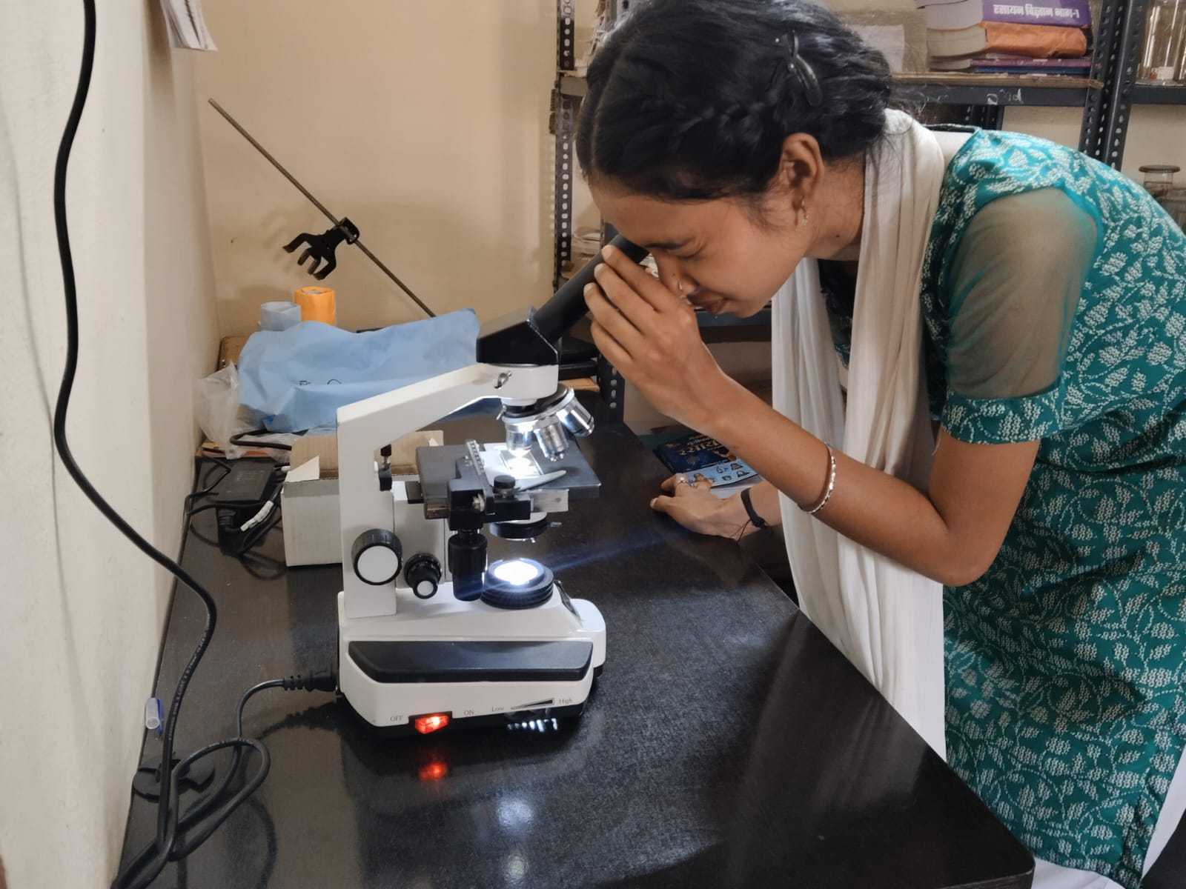
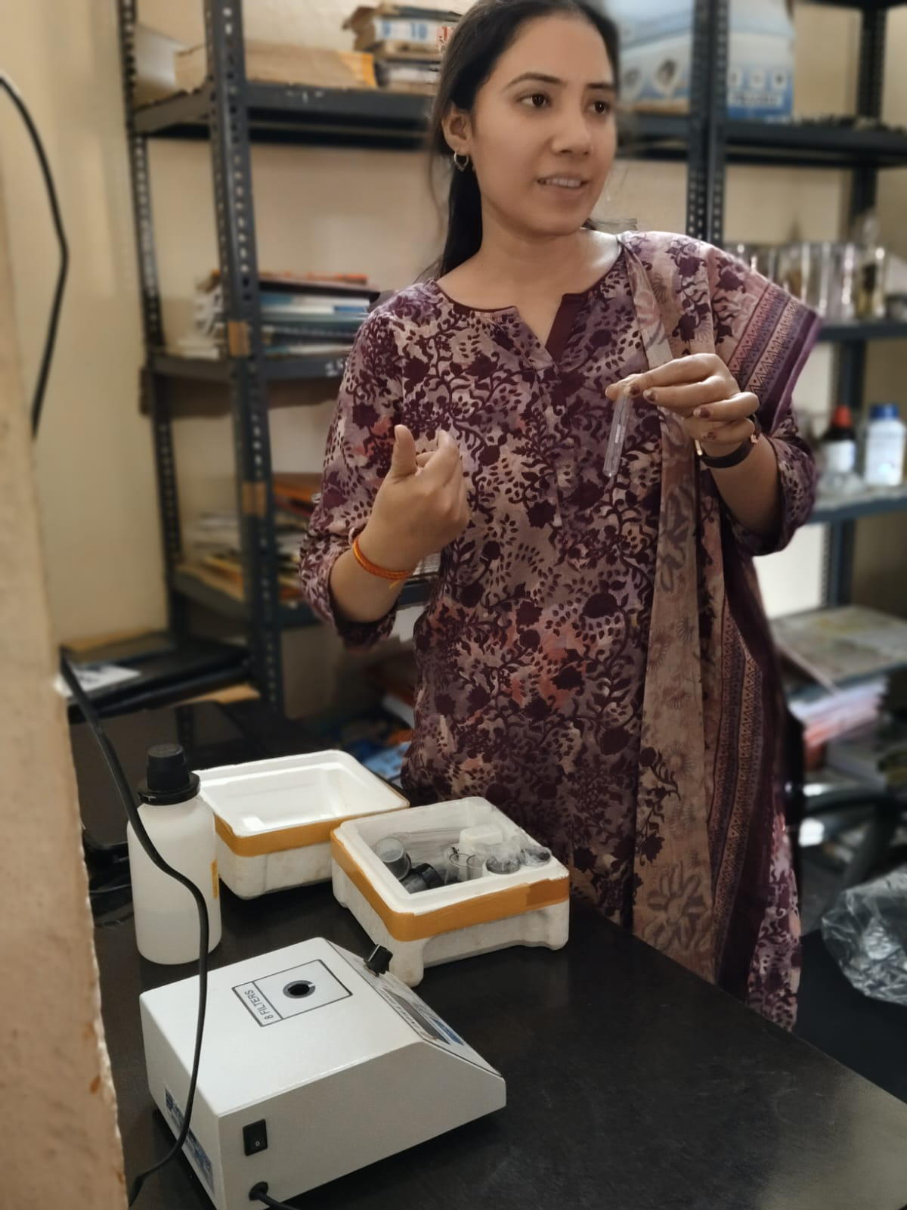
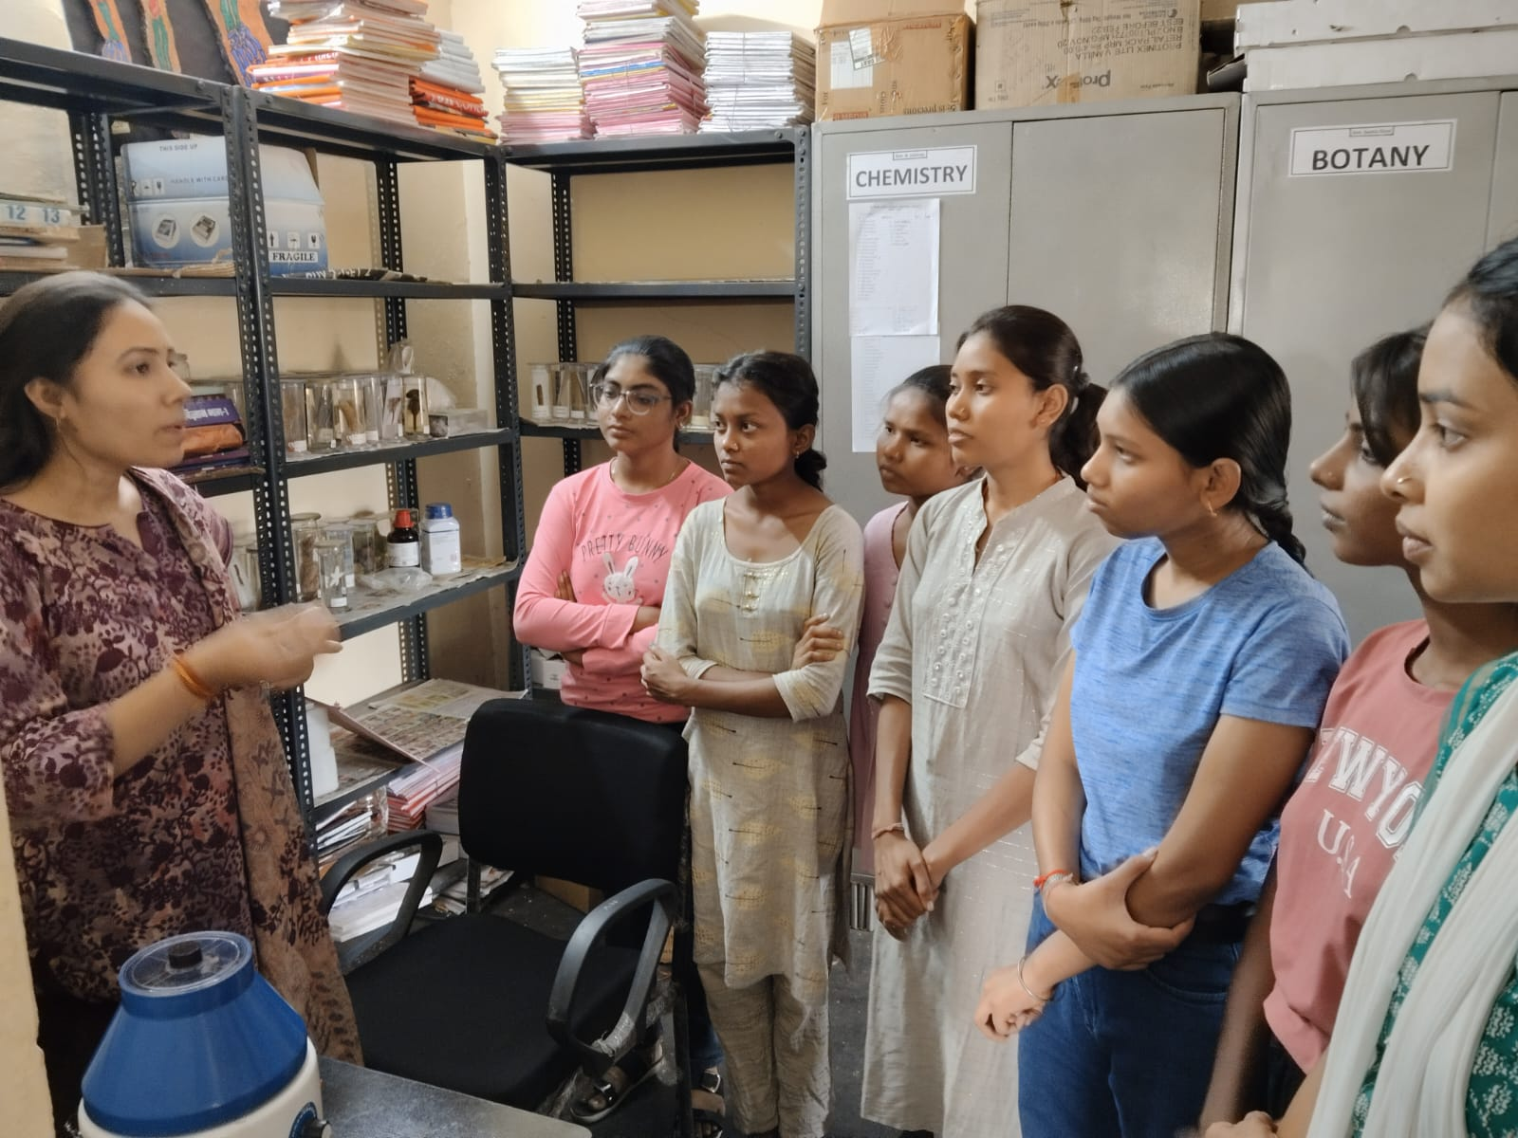
College Website - http://gnckumhari.in
LABORATORIES

Slide 9
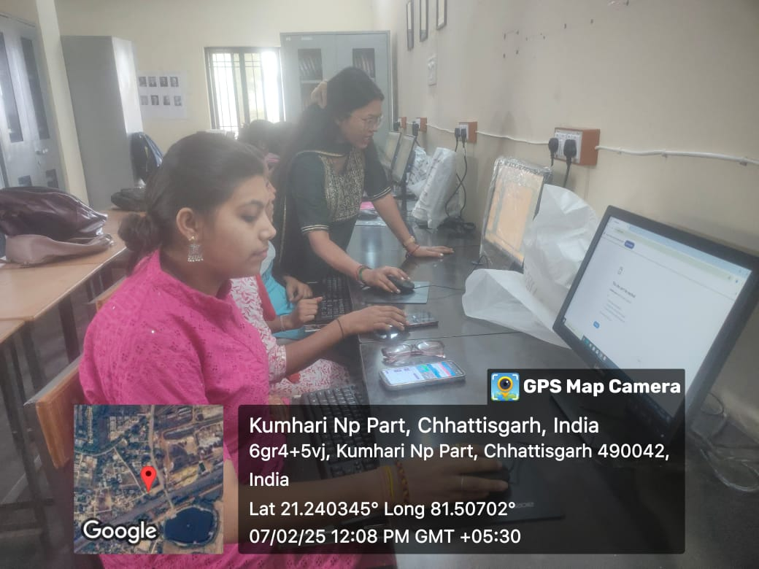
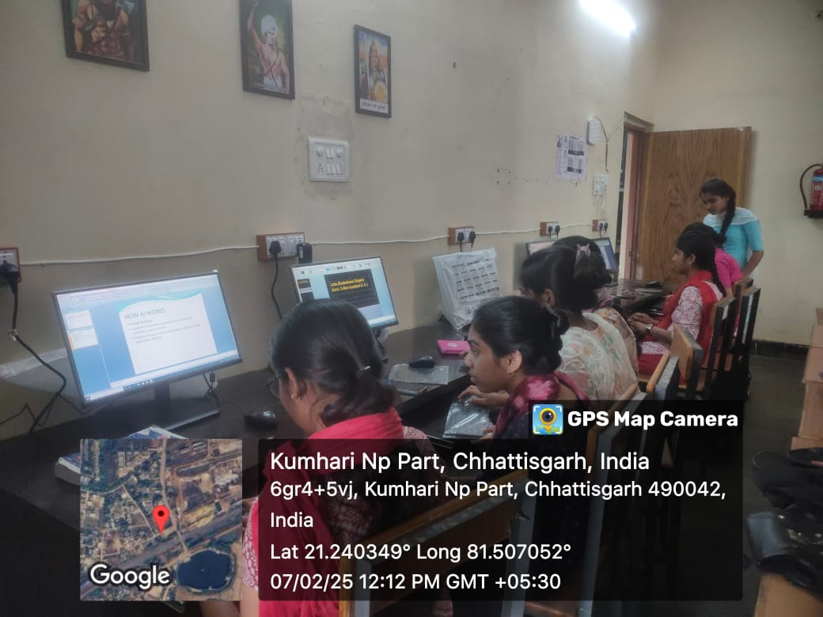
College Website - http://gnckumhari.in
Library/Digital Library
Registration of NDLI

Slide 10
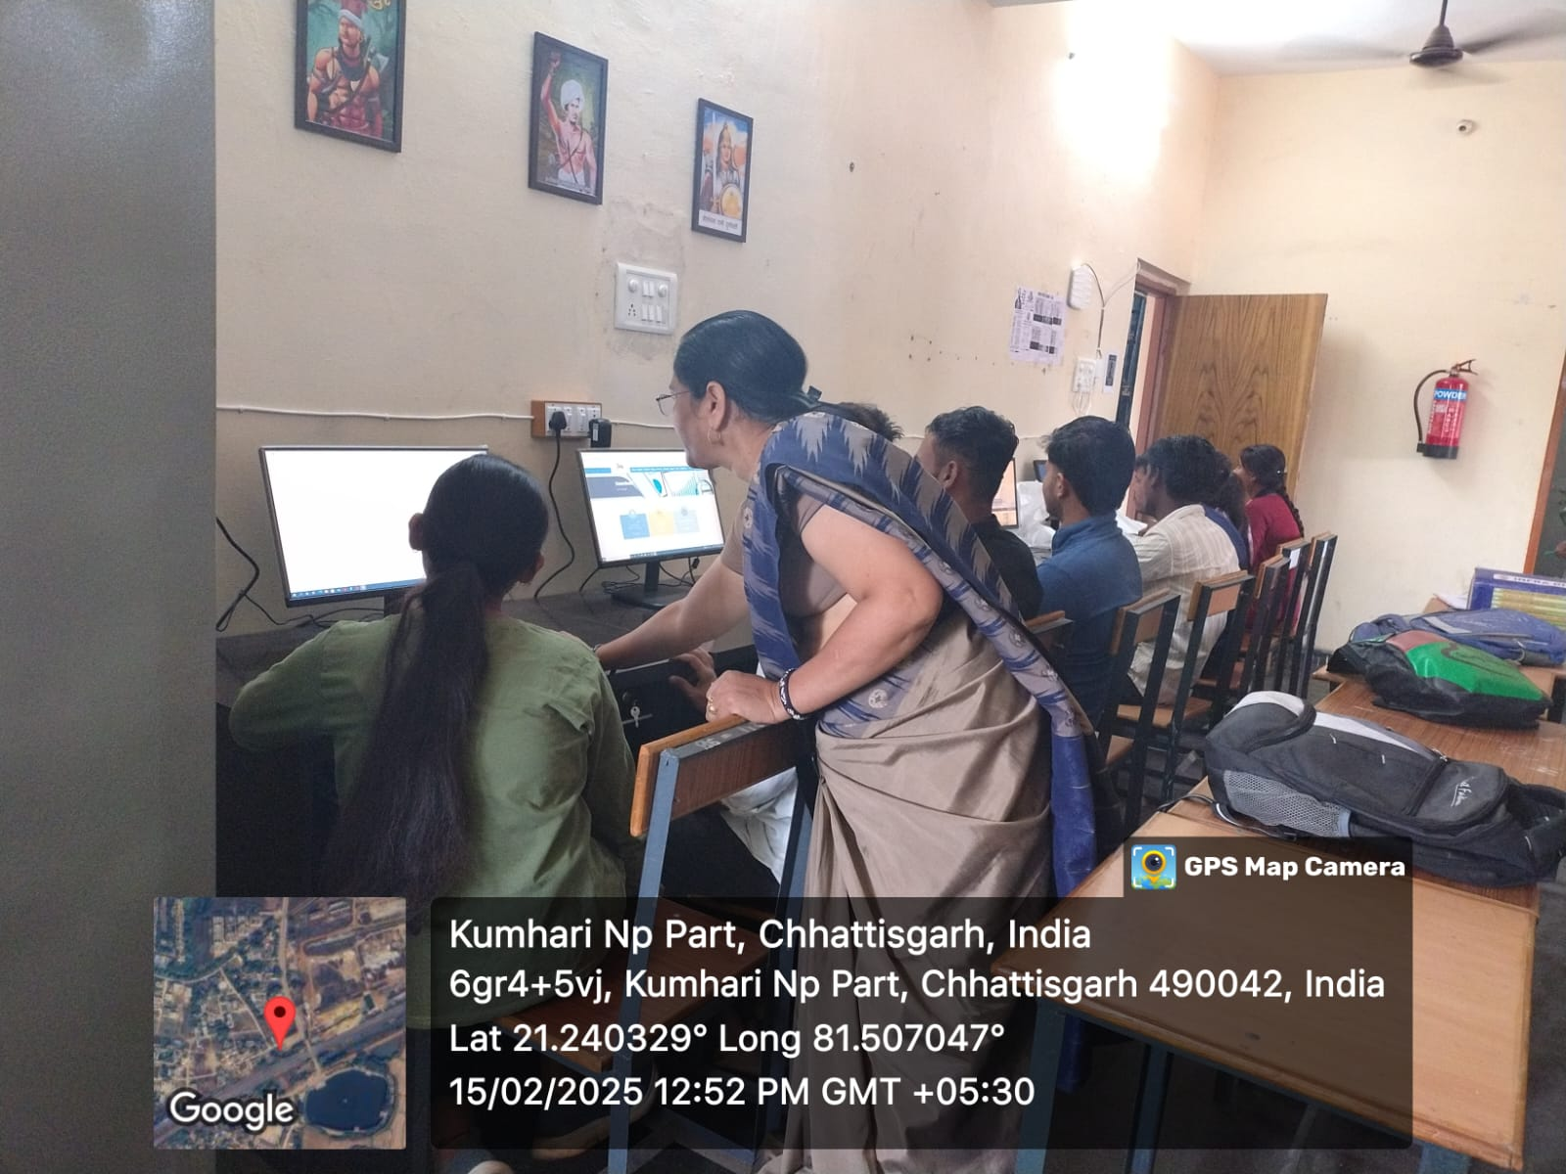
College Website - http://gnckumhari.in
Computer Lab / Internet WIFI Facility

Slide 11
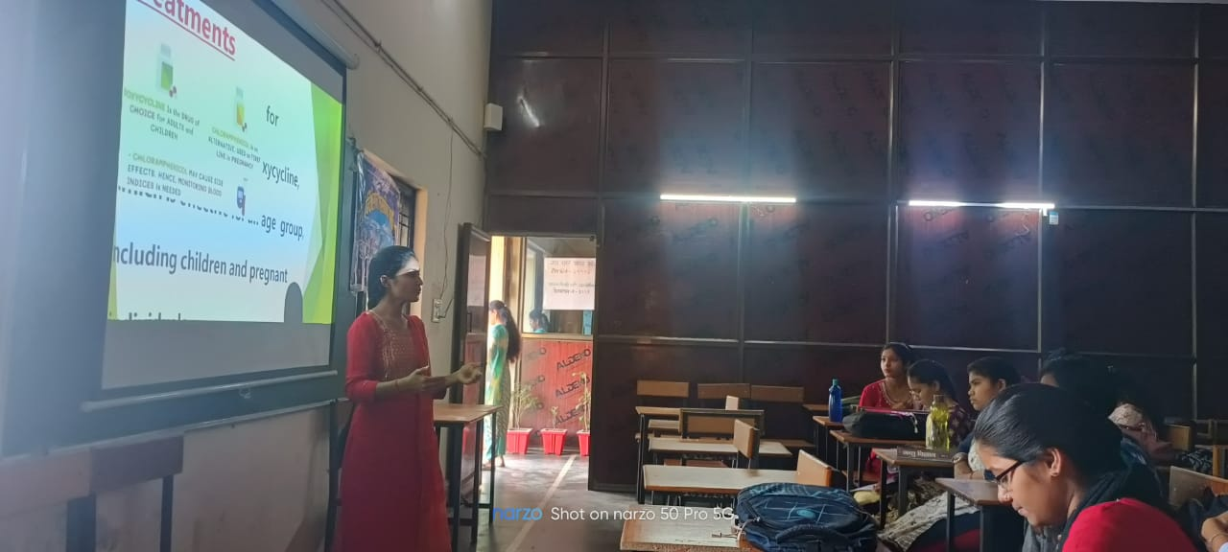
College Website - http://gnckumhari.in
ICT CLASSES

Slide 12
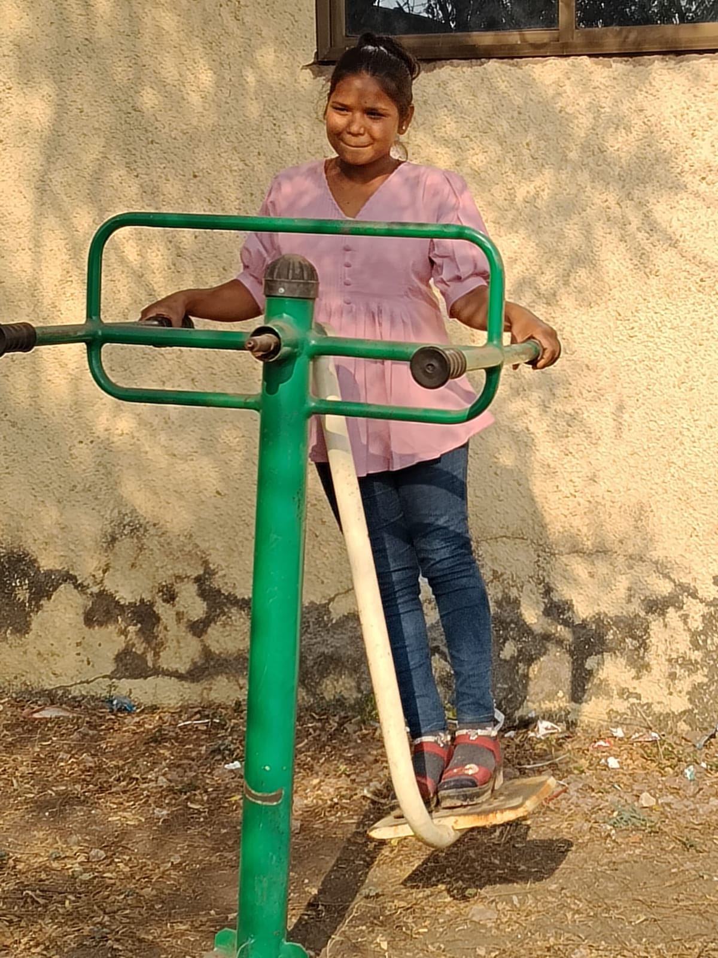
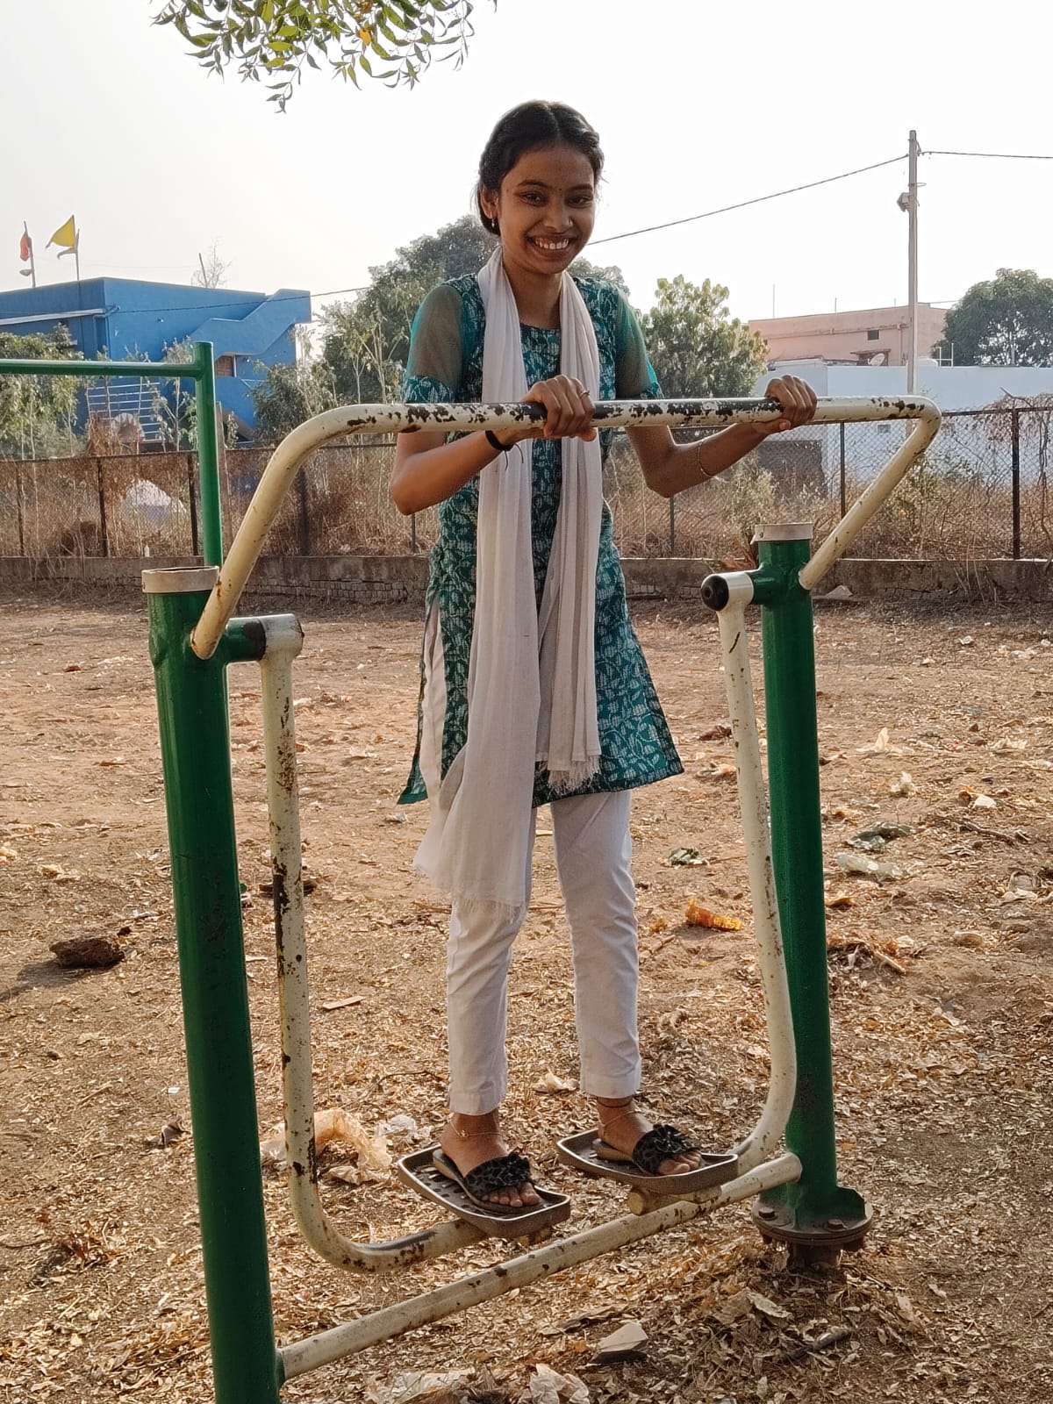
College Website - http://gnckumhari.in
OPEN GYM

Slide 13
College Website - http://gnckumhari.in
CCTV CAMERA PROTECTED CAMPUS

Slide 14
College Website - http://gnckumhari.in
Addiction free college campus

Slide 15
College Website - http://gnckumhari.in
Ragging-Free Campus.

Slide 16
College Website - http://gnckumhari.in
Committee for Prevention of Women's Harassment

Slide 17
College Website - http://gnckumhari.in
NAAC REGISTERED COLLEGE

Slide 18
College Website - http://gnckumhari.in
HIGHLY QUALIFIED FACULTY MEMBERS.
INDIVIDUAL ATTENTION TO EACH AND EVERY STUDENTS.
MENTOR –MENTEE SCHEME.
SCIENCE ASSOCIATION.
BOOKS ON ALL SUJBECTS ARE AVAILABLE IN THE COLLEGE LIBRARY.

Slide 19
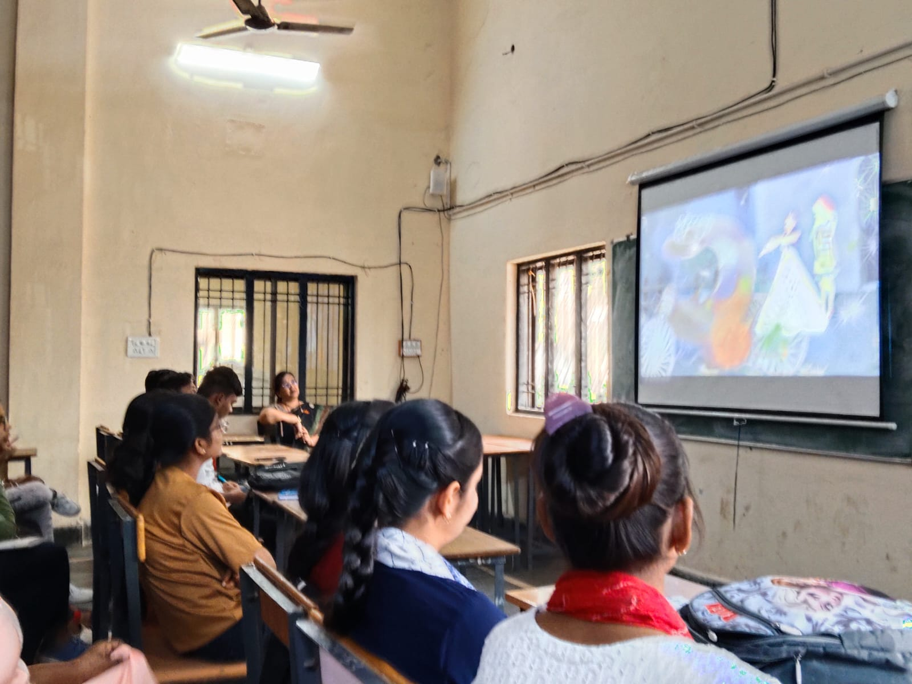
College Website - http://gnckumhari.in
English Club

Slide 20
College Website - http://gnckumhari.in
CAMPUS LIFE
CULTURAL ACTIVITIES
SPORTS
MOU AND PLACEMENT
EXTRACURRICULAR ACTIVITIES
SEMINAR/ WORKSHOP
INDUSTRIAL VISIT

Slide 21
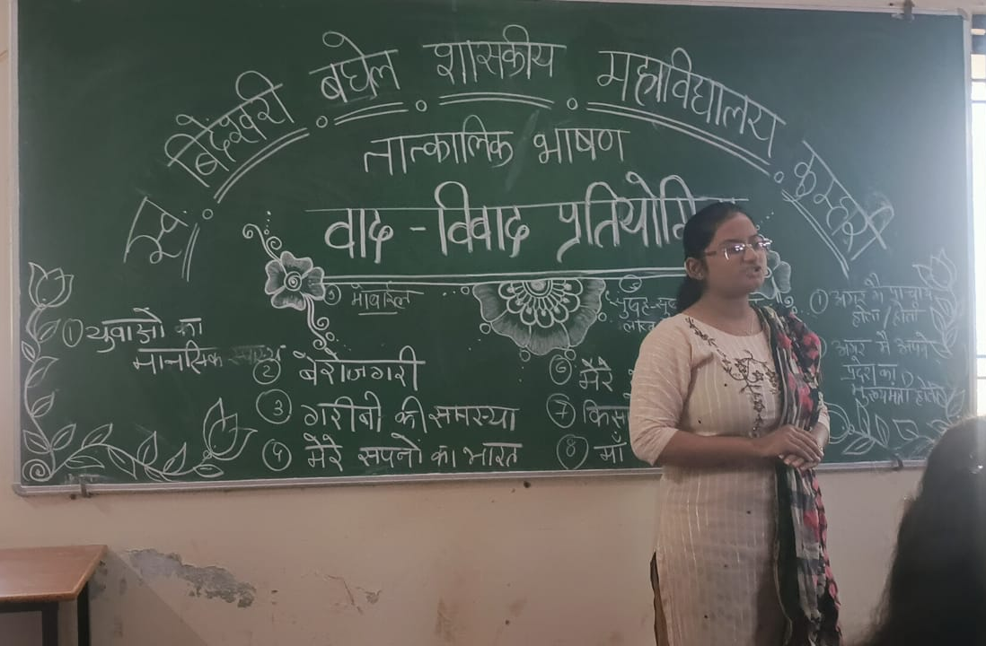
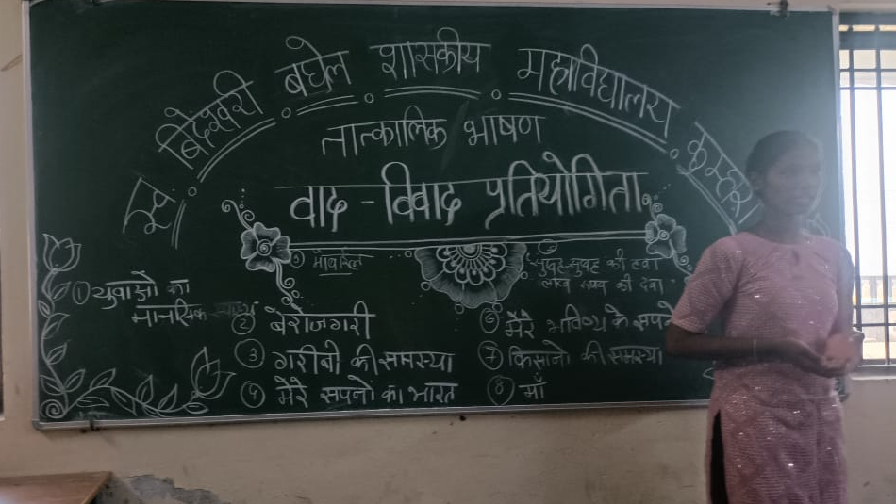
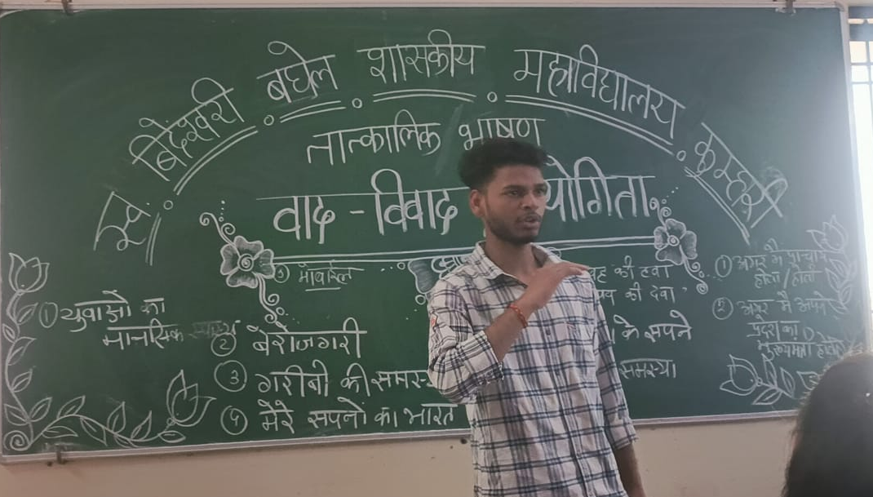
College Website - http://gnckumhari.in
CULTURAL AND LITERARY ACTIVITIES
DEBATE, SPEECH AND EXTEMPORE COMPETITION

Slide 22
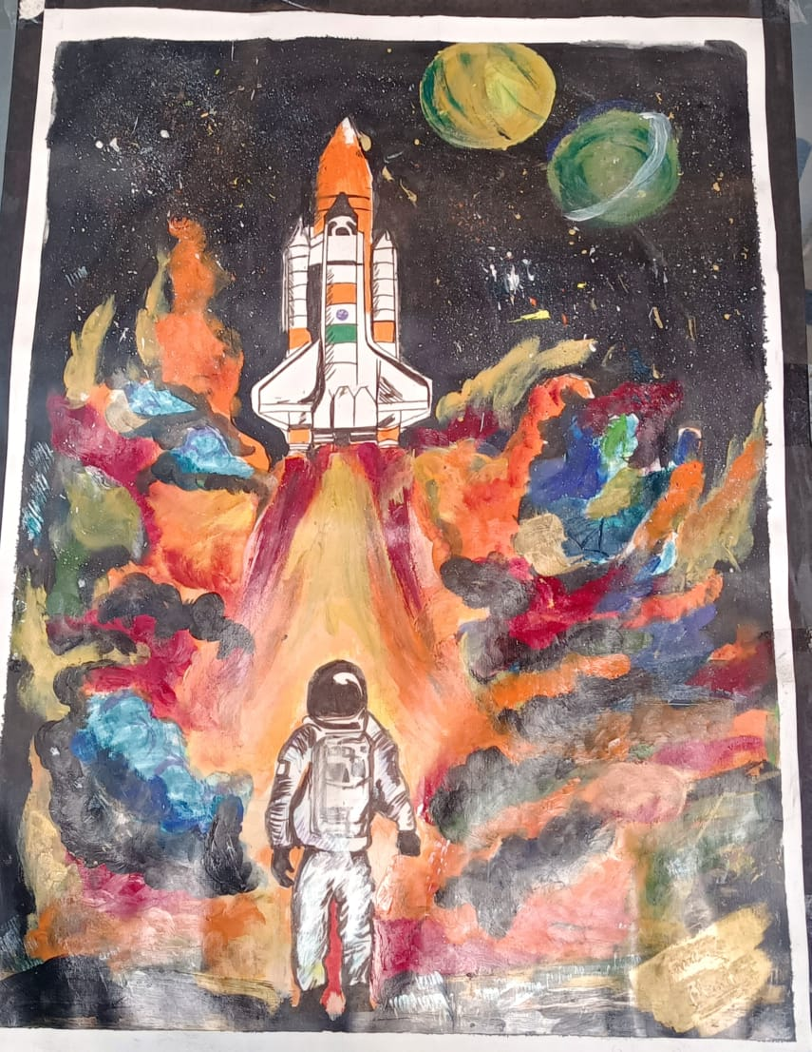
College Website - http://gnckumhari.in
POSTER MAKING COMPETITION

Slide 23
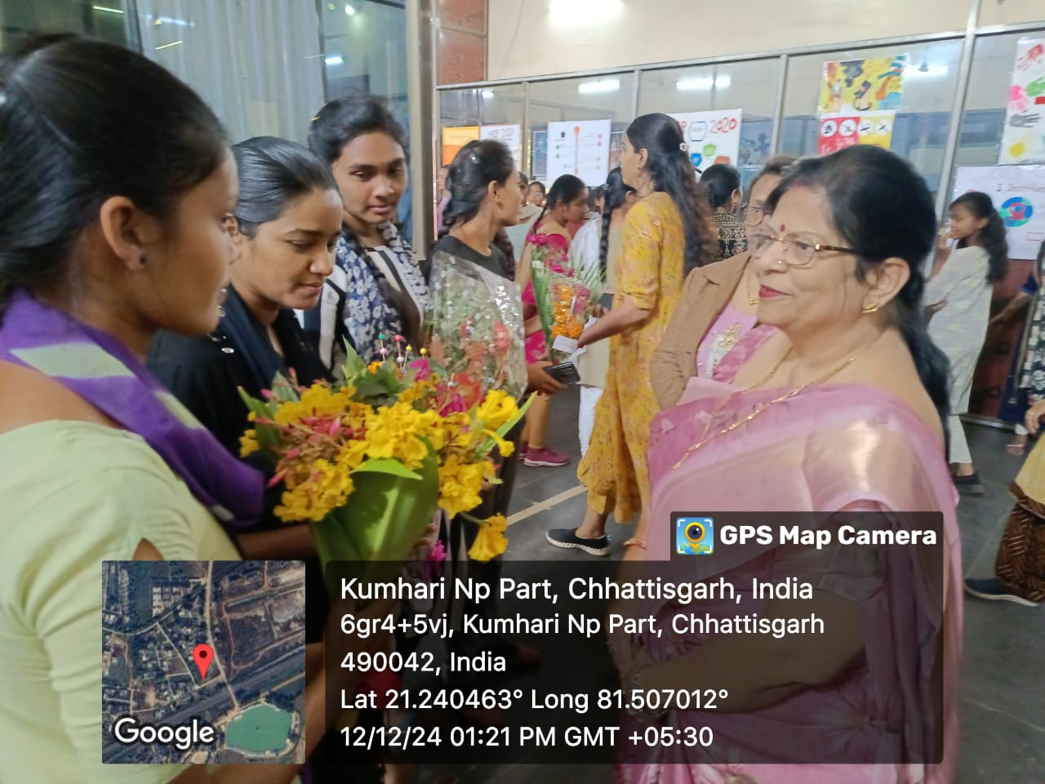
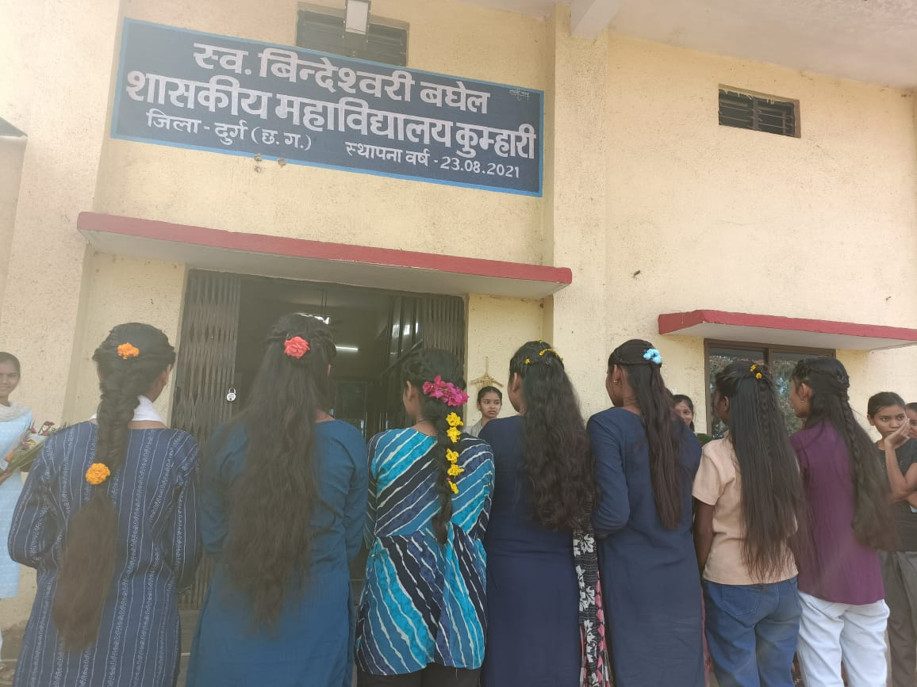
College Website - http://gnckumhari.in
HAIR STYLE AND FLOWER BUCKET MAKING COMPETITION

Slide 24
College Website - http://gnckumhari.in
MEHANDI COMPETITION

Slide 25
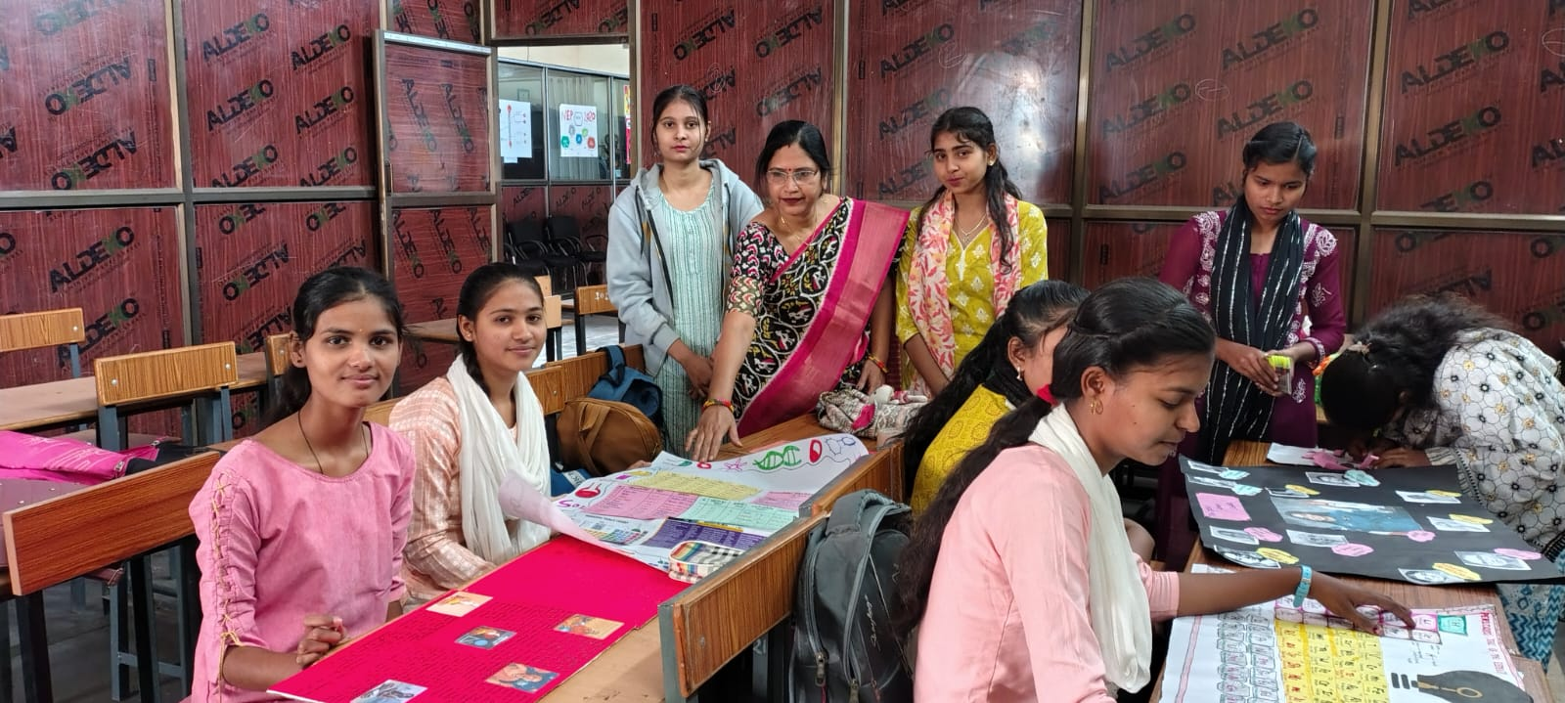
College Website - http://gnckumhari.in
COLLAGE COMPETITION

Slide 26
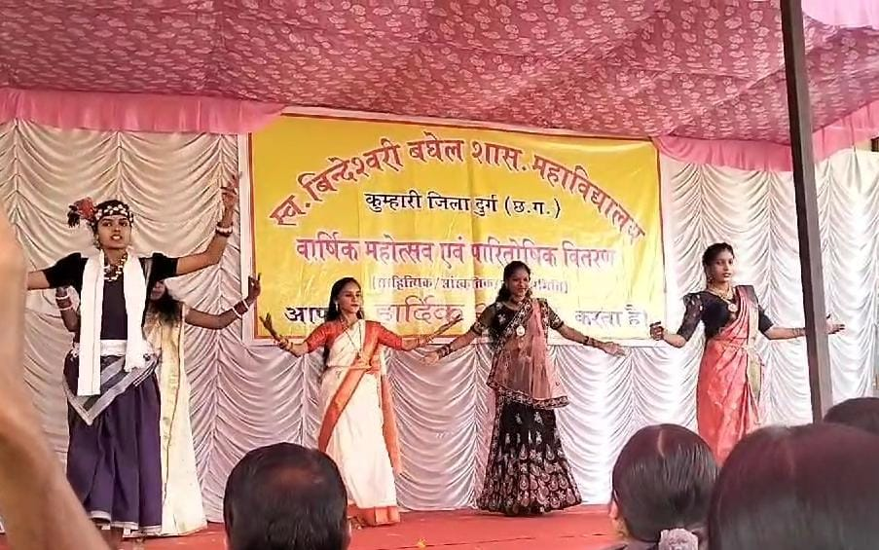
College Website - http://gnckumhari.in
FOLK DANCE

Slide 27
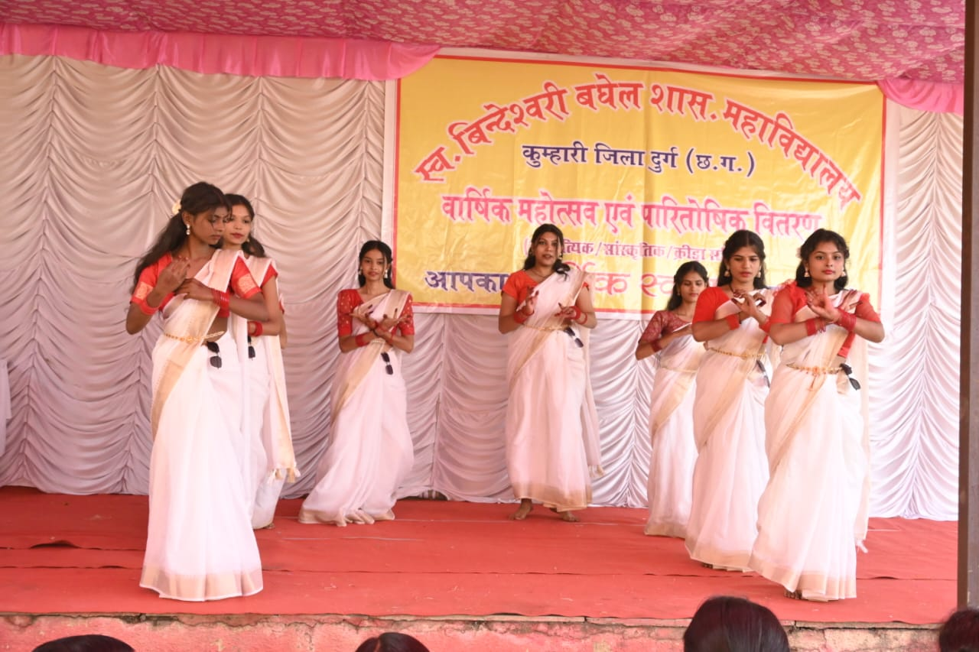
College Website - http://gnckumhari.in

Slide 28
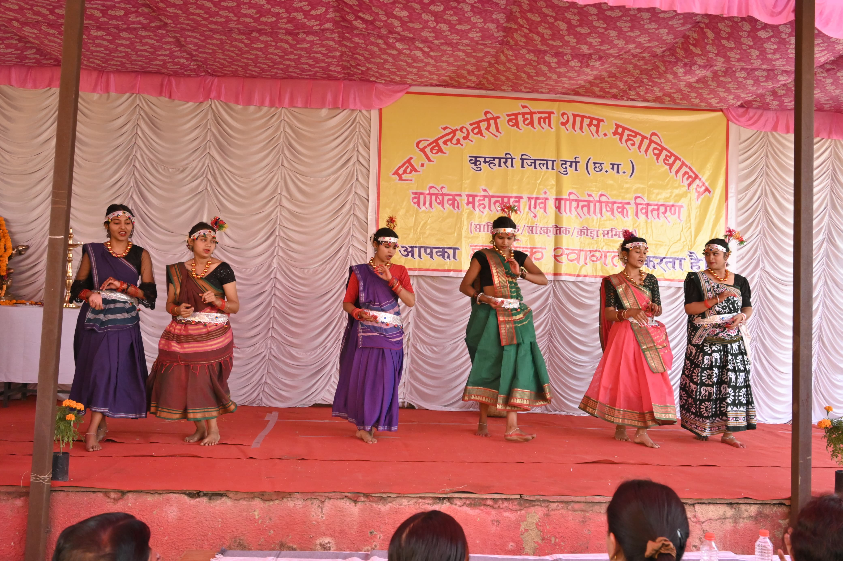
College Website - http://gnckumhari.in

Slide 29
College Website - http://gnckumhari.in
SPORTS
CRICKET

Slide 30
College Website - http://gnckumhari.in
BADMINTON

Slide 31
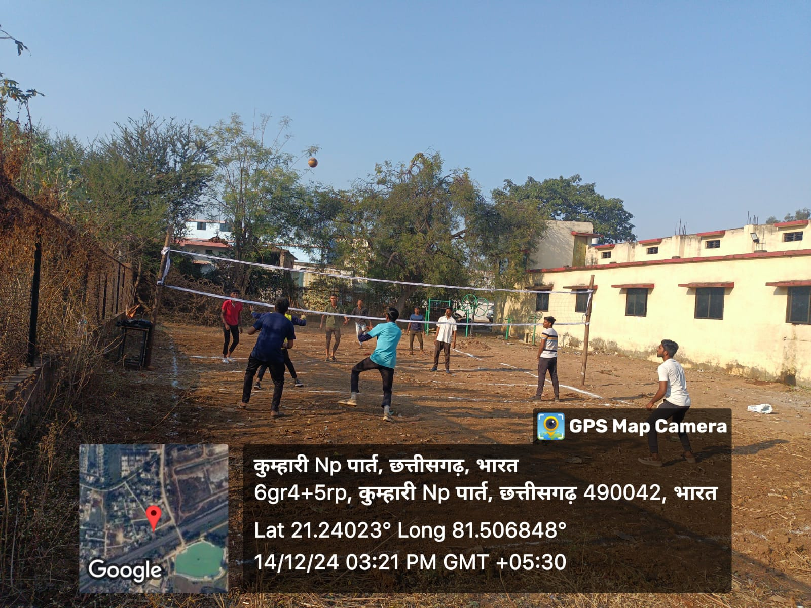
College Website - http://gnckumhari.in
VOLLEY BOLL

Slide 32
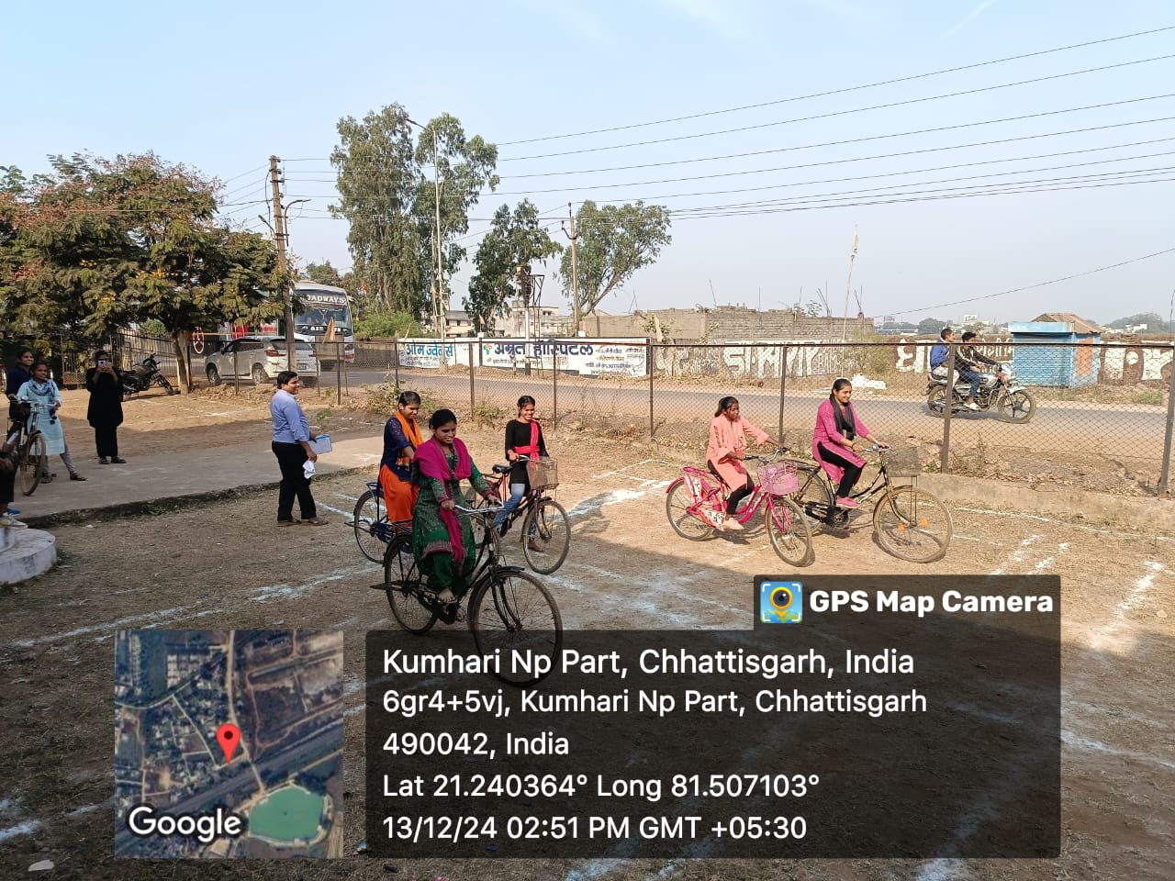
College Website - http://gnckumhari.in
SLOW CYCLE RACE

Slide 33
College Website - http://gnckumhari.in
SHORT PUT

Slide 34
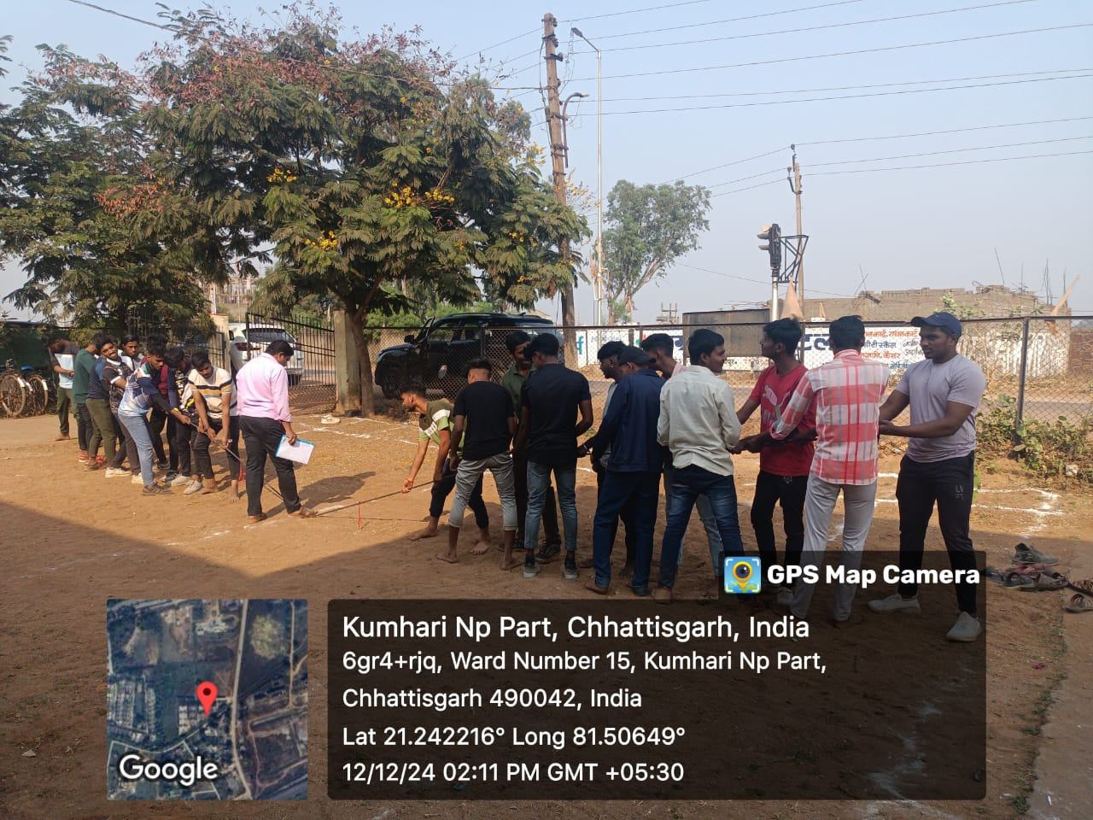
College Website - http://gnckumhari.in
TUG OF WAR

Slide 35
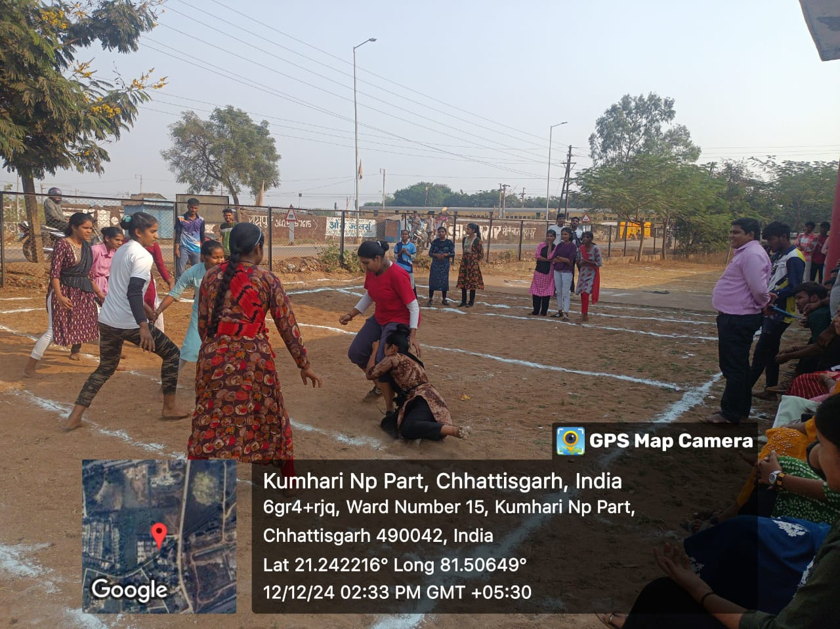
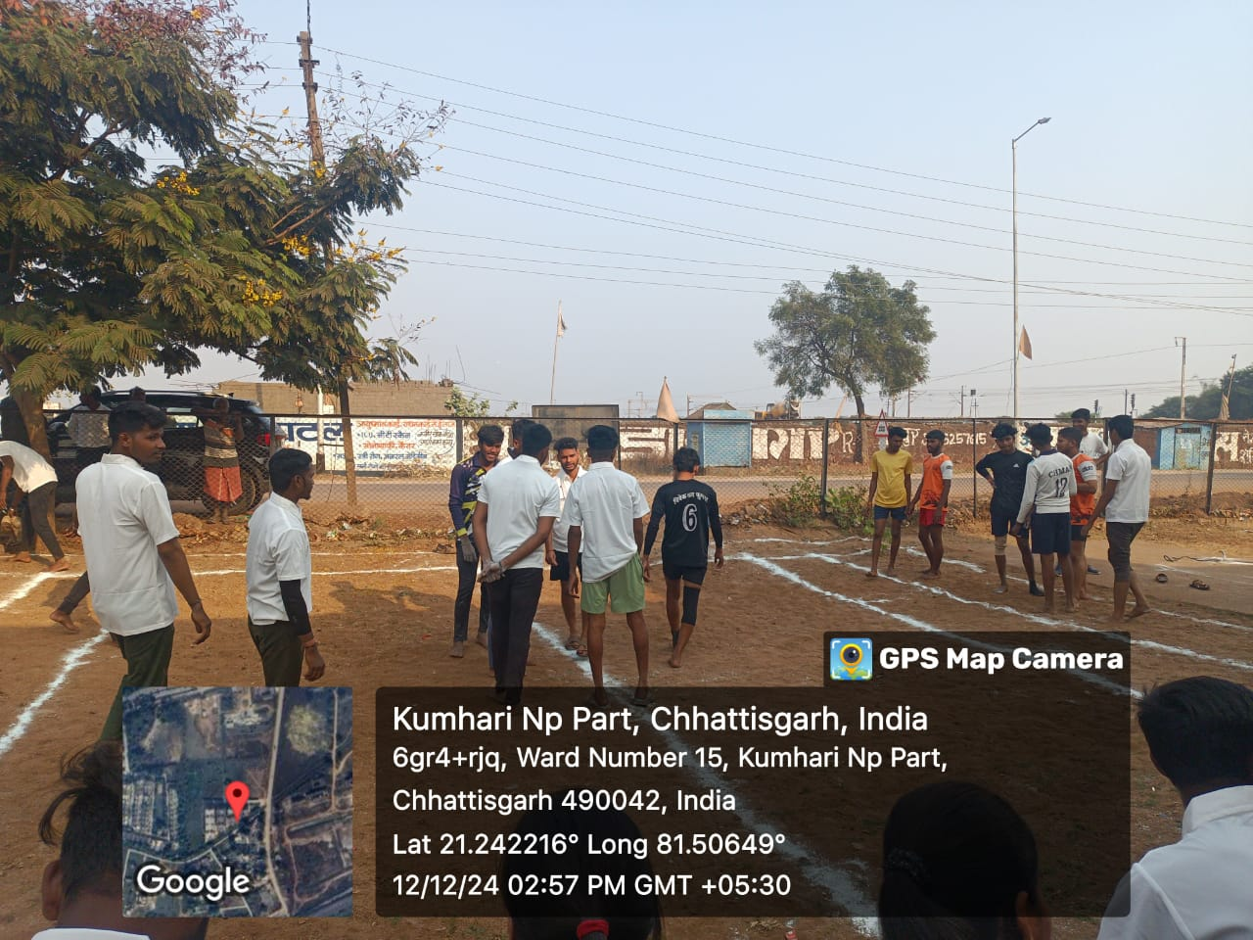
College Website - http://gnckumhari.in
KABADDI

Slide 36
College Website - http://gnckumhari.in
KHO-KHO

Slide 37
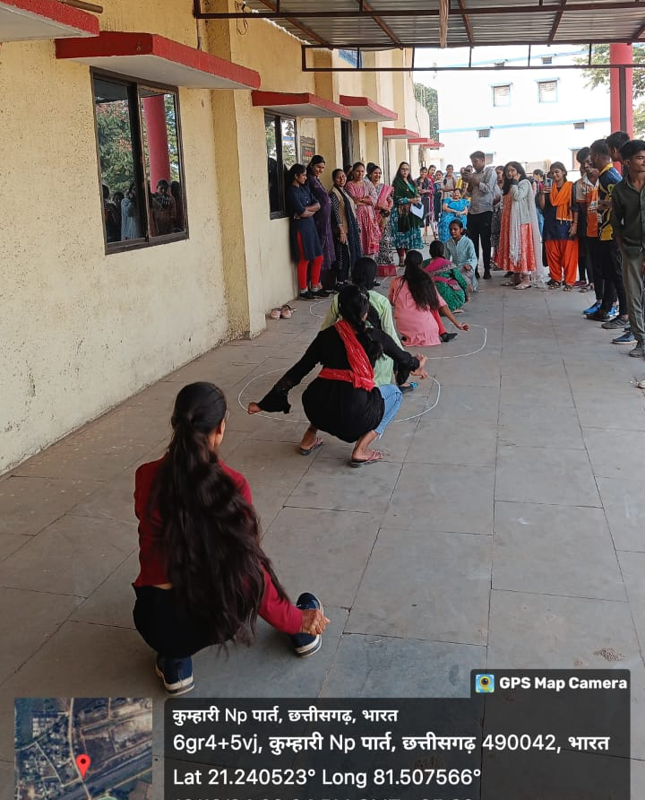
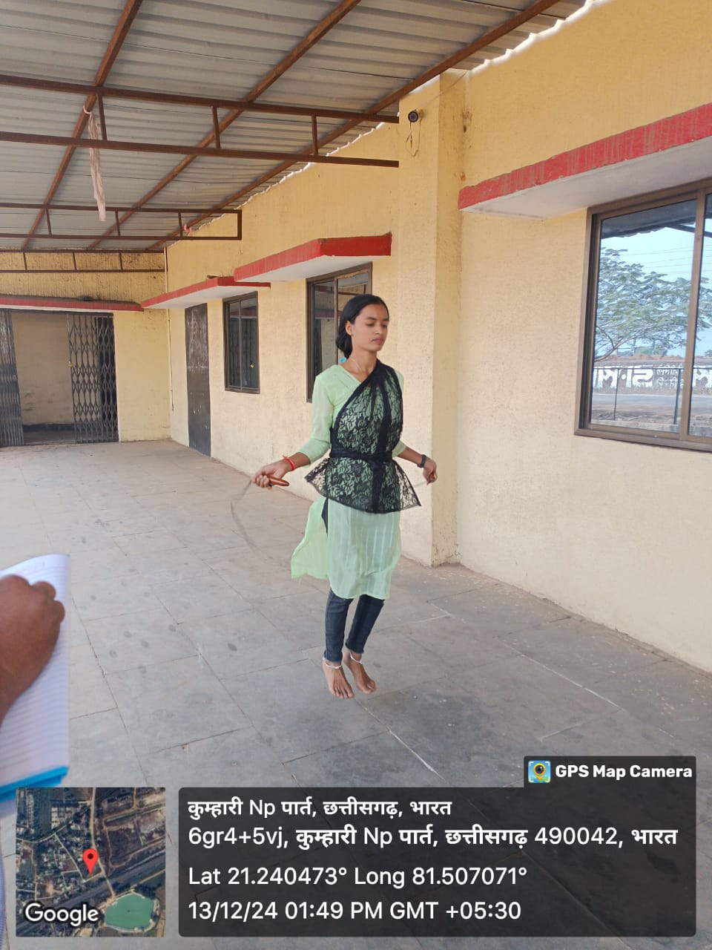
College Website - http://gnckumhari.in
FUGDI AND JUMPING ROPE

Slide 38
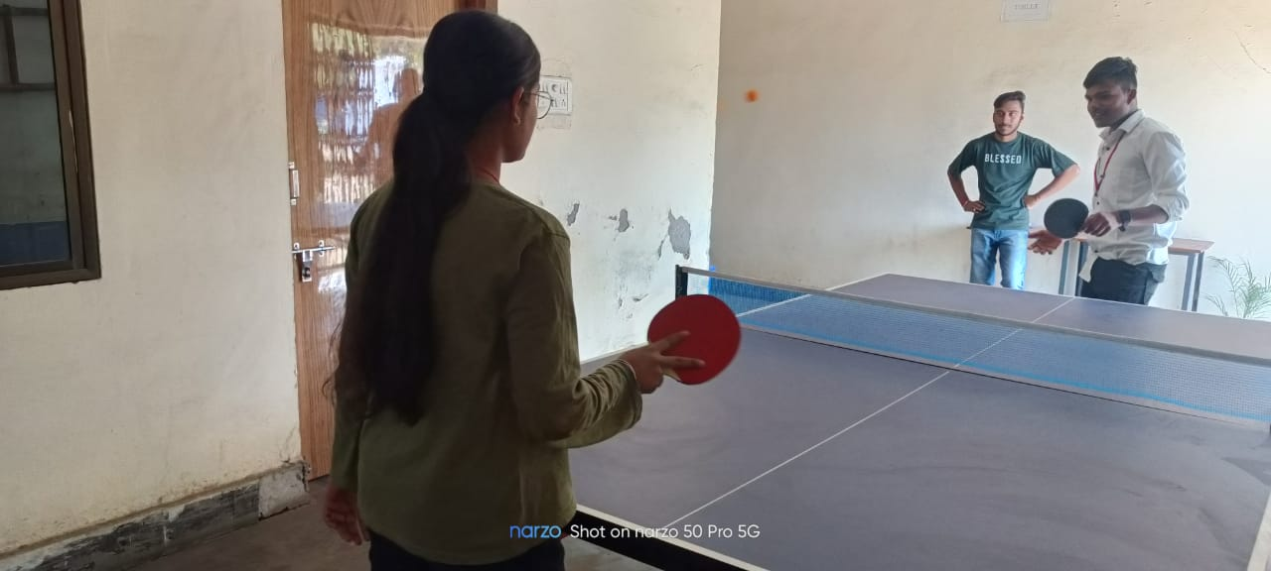
College Website - http://gnckumhari.in
Table Tennis

Slide 39
College Website - http://gnckumhari.in
Carrom board

Slide 40
College Website - http://gnckumhari.in
SEMINAR BY KEYNOTE SPEAKER

Slide 41
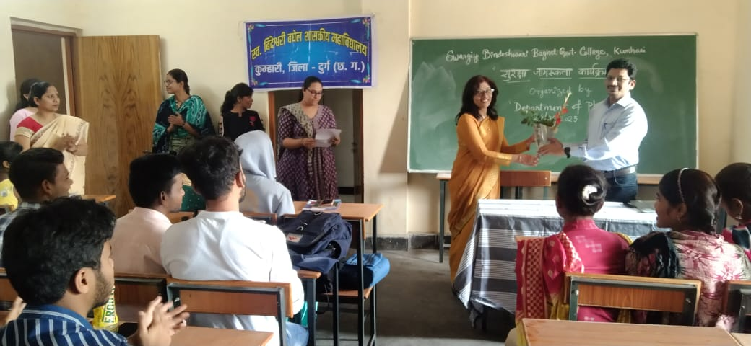
College Website - http://gnckumhari.in
SURKSHA JAGRUKTA KARYAKARM

Slide 42
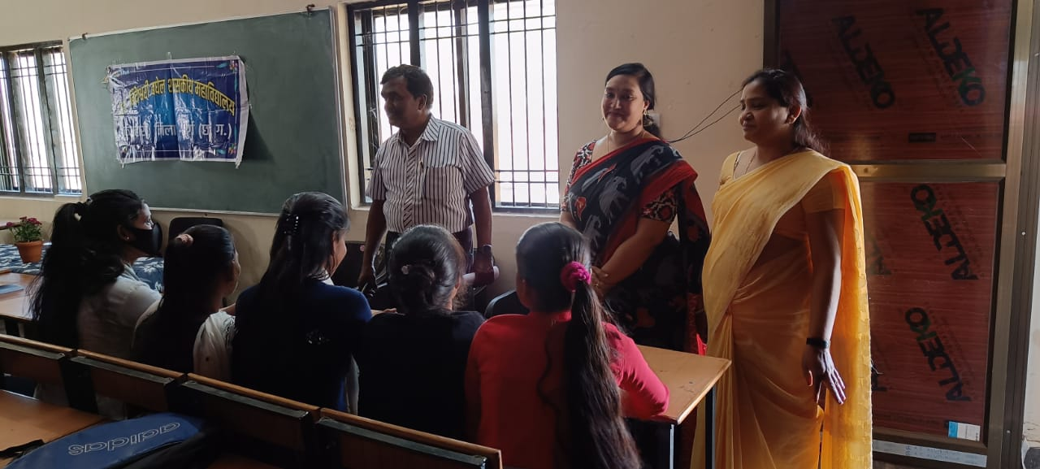
College Website - http://gnckumhari.in
GUEST LECTURE ON VALUE EDUCATION

Slide 43
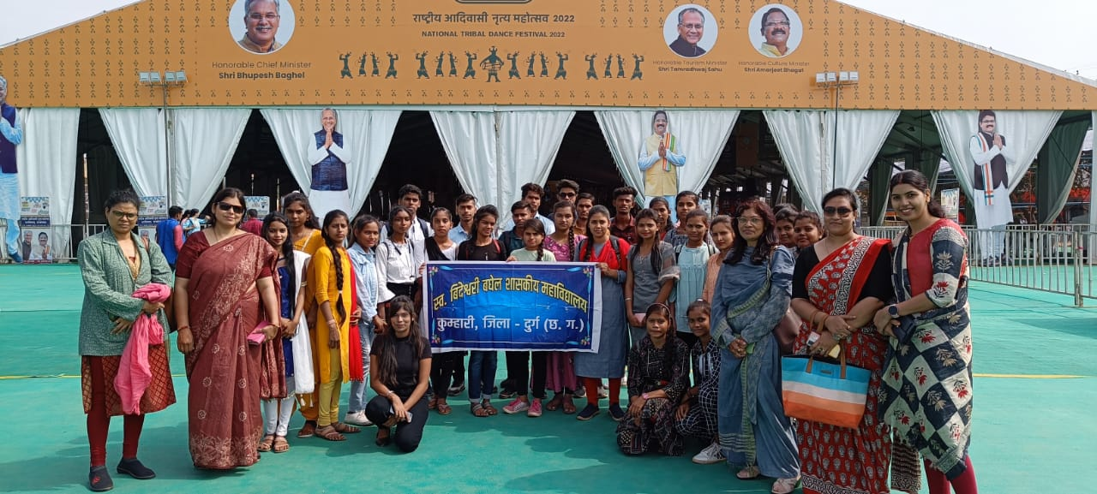
College Website - http://gnckumhari.in
VISIT TO RAJOTSAV

Slide 44
College Website - http://gnckumhari.in
HANDS ON TRAINING WORKSHOP BY EXPERTISE

Slide 45
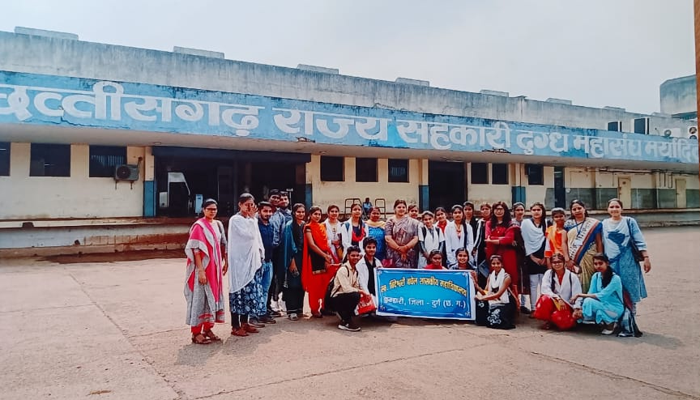
College Website - http://gnckumhari.in
INDUSTRIAL VISIT

Slide 46
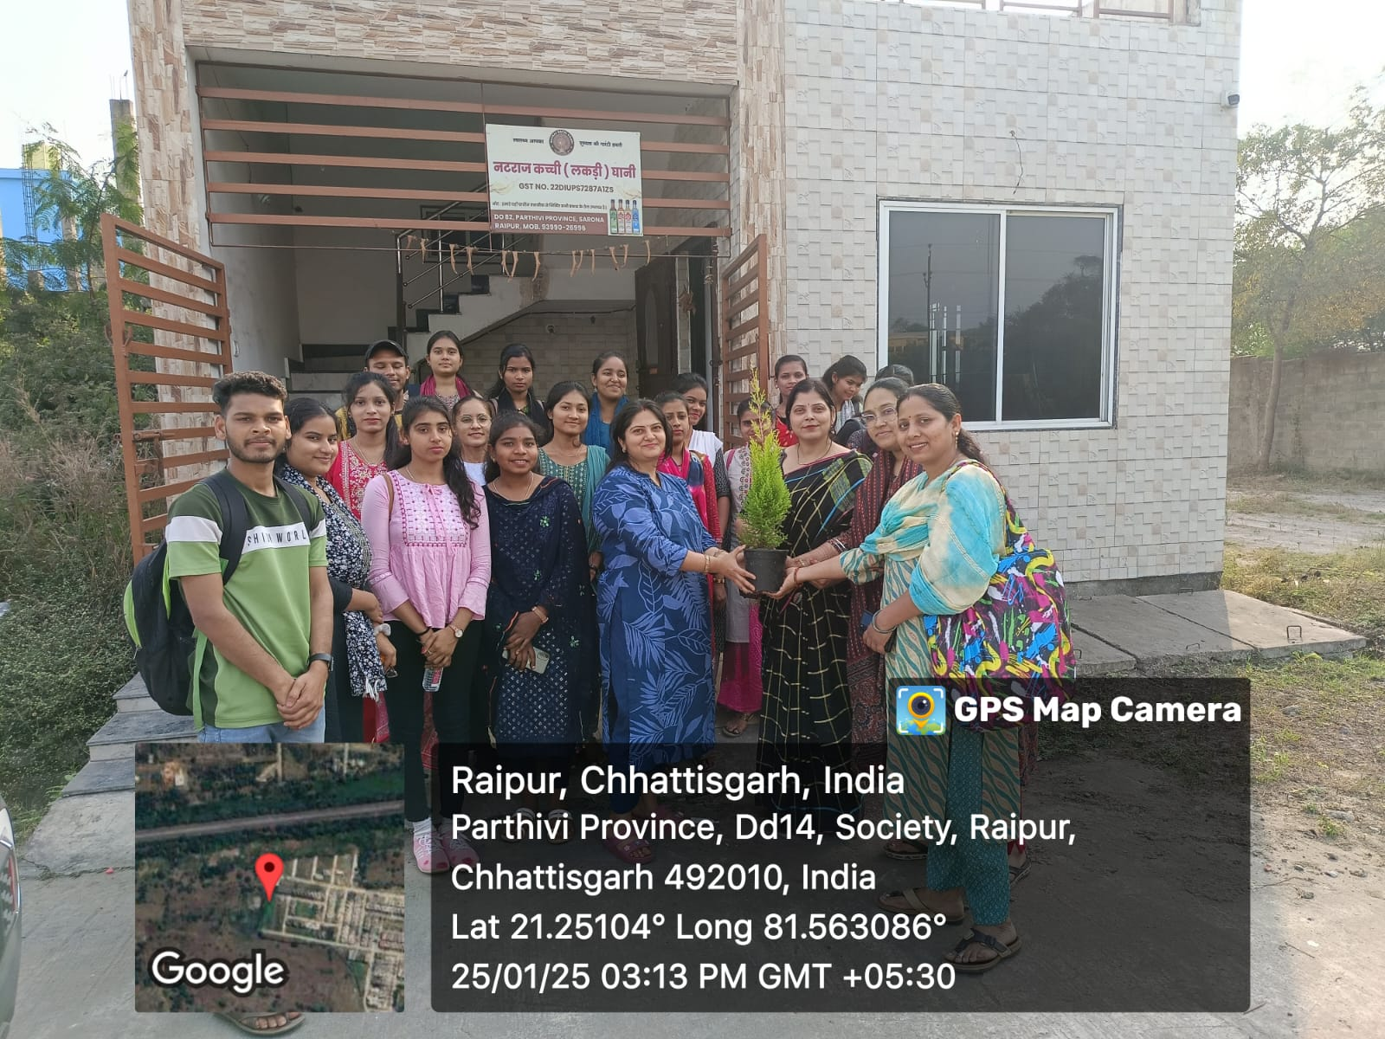
College Website - http://gnckumhari.in
INDUSTRIAL VISIT
Industrial visit at Natraj Oil Industry, Raipur

Slide 47
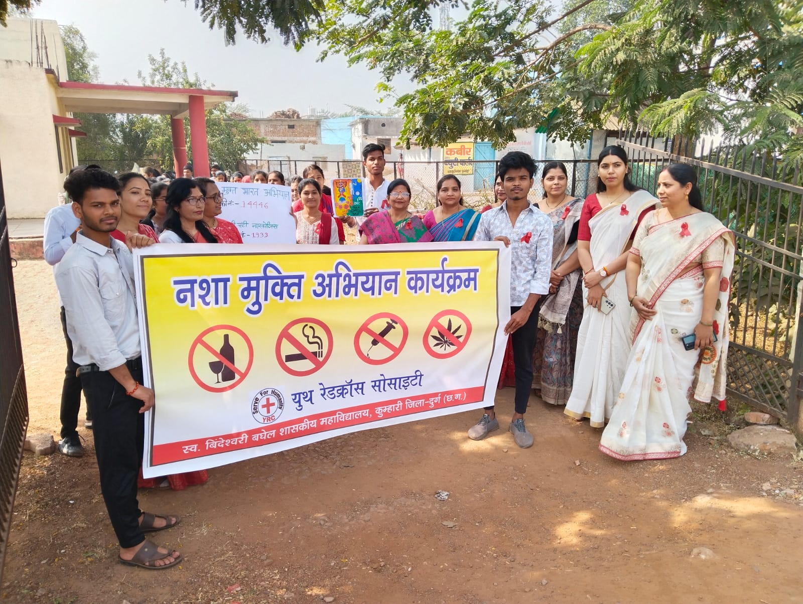
College Website - http://gnckumhari.in
SERVIES FOR COMMUNITY: YOUTH RED CROSS SOCIETY

Slide 48
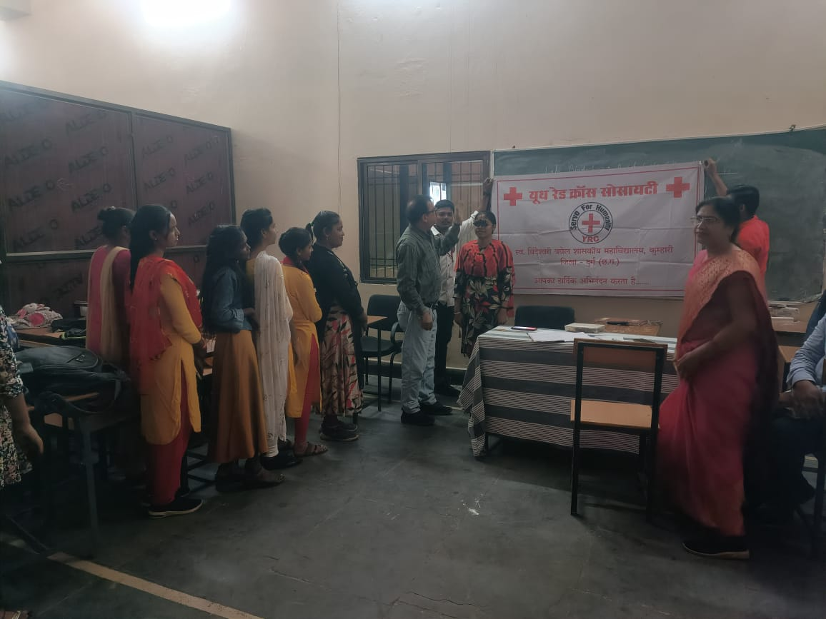
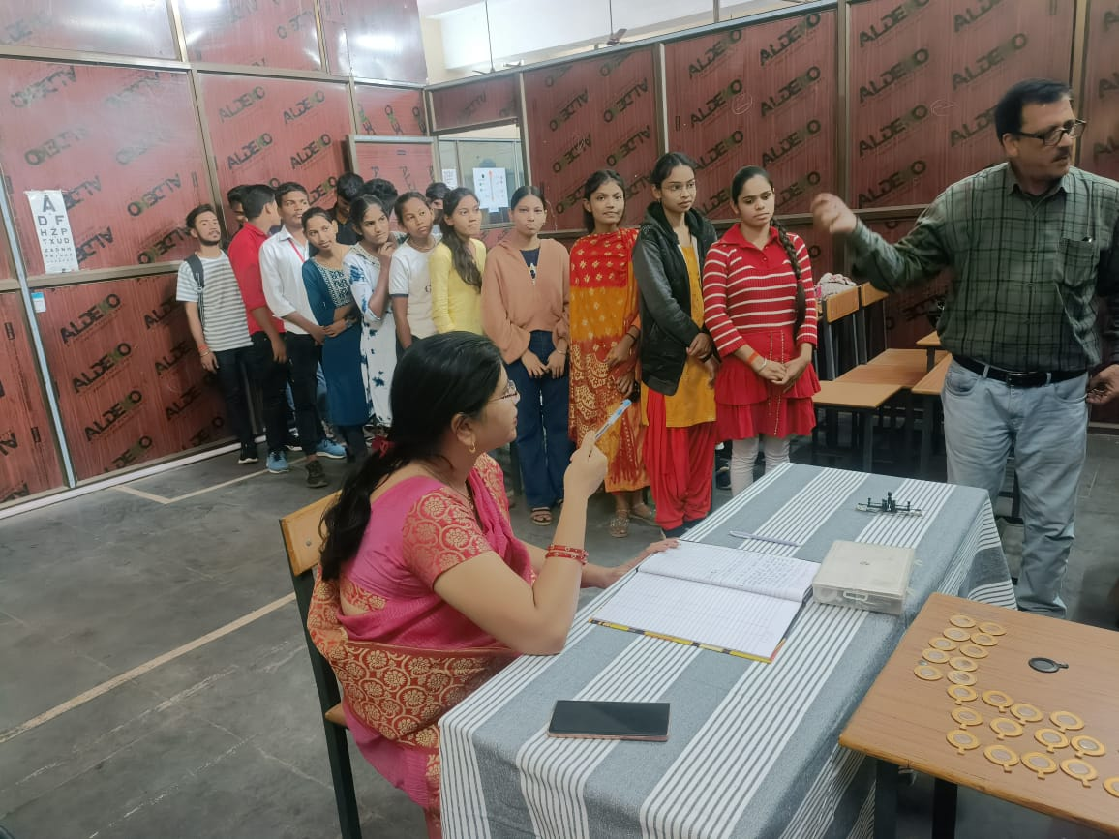
College Website - http://gnckumhari.in
HEALTH CHECKUP CAMP

Slide 49
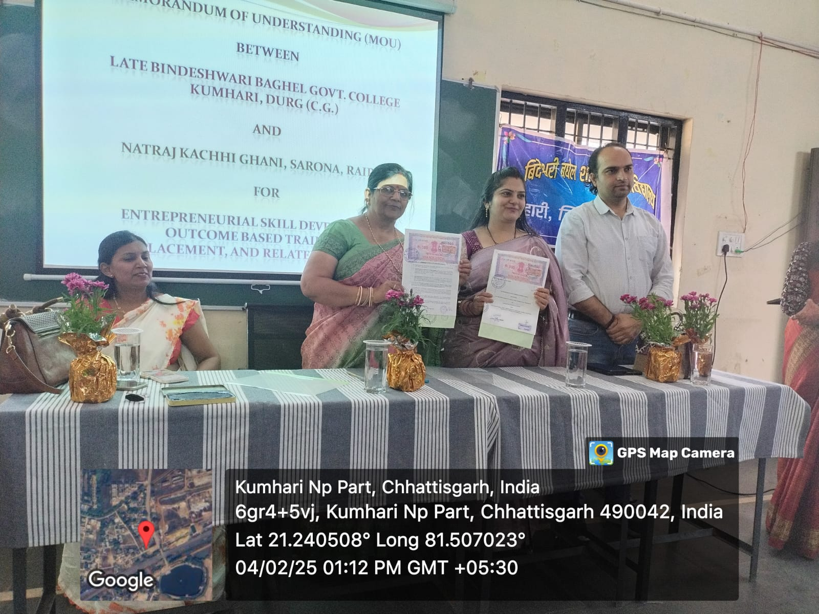
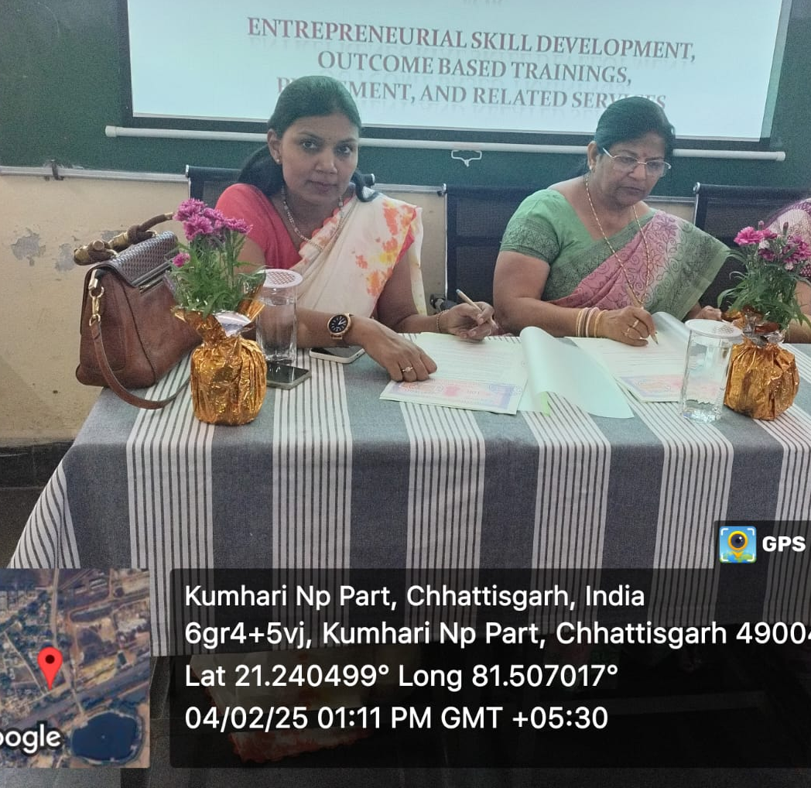
College Website - http://gnckumhari.in
MOU
1. MOU with Natraj Kacchi Ghani, Raipur
2. MOU with Siddhachalam Laboratory, Raipur

Slide 50
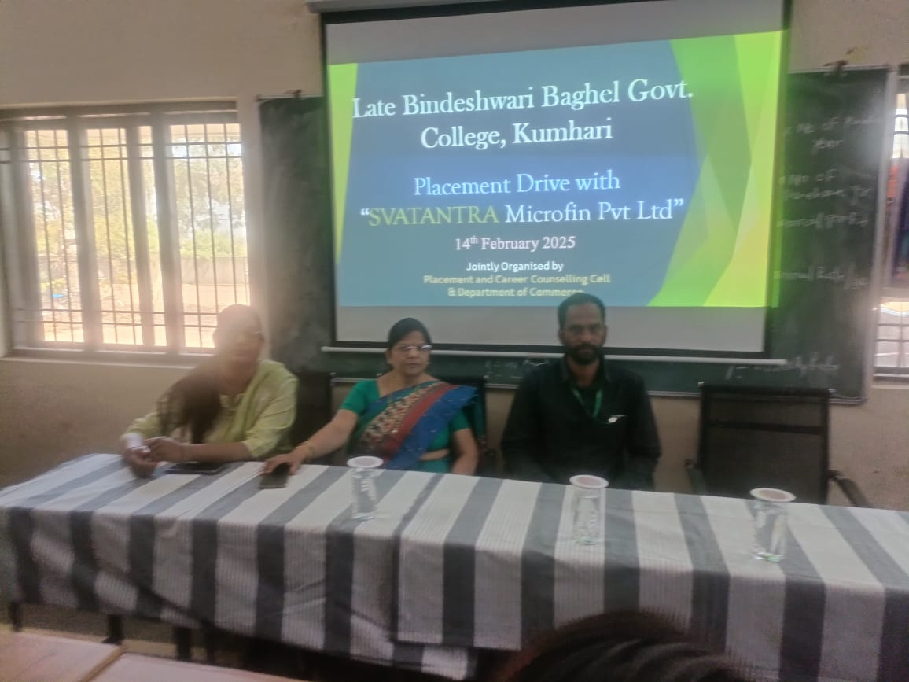
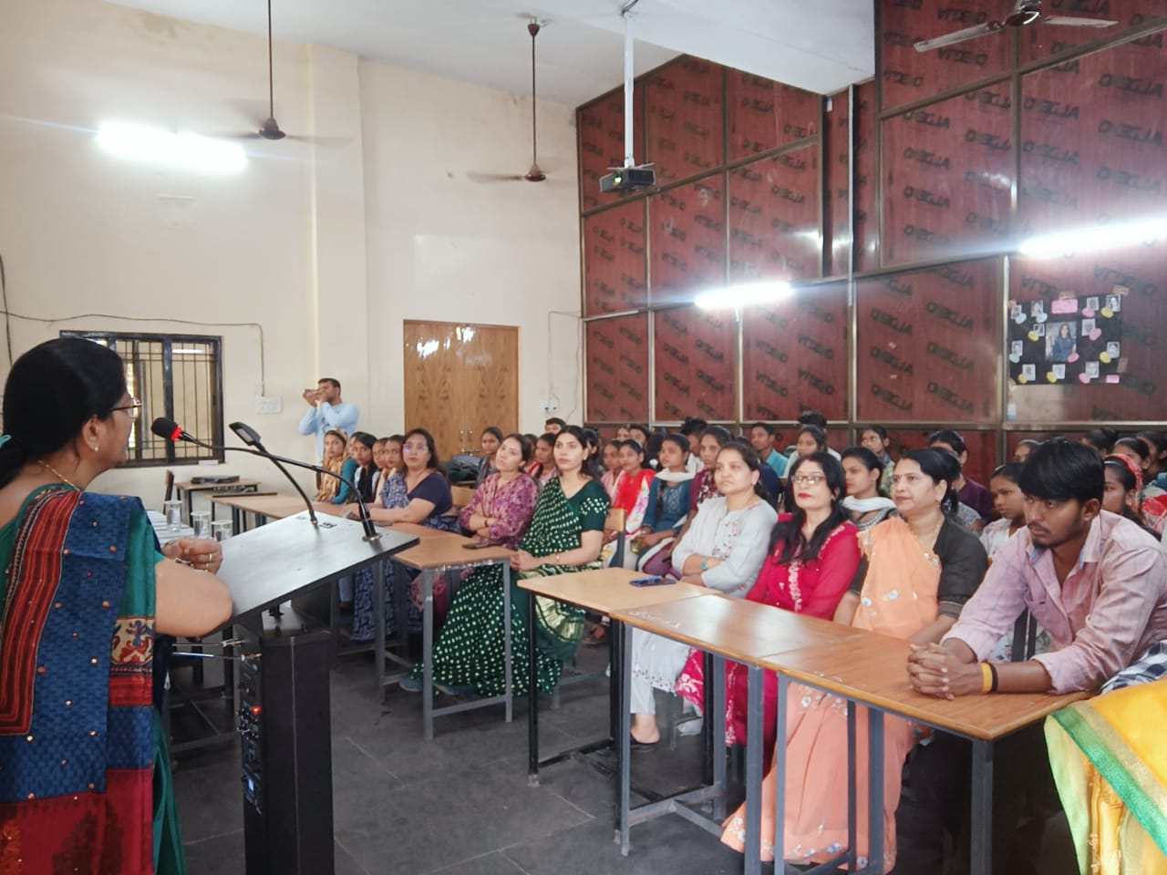
College Website - http://gnckumhari.in
PLACEMENT
The Placement Cell organized a placement drive with SWATANTRA Microfin Pvt. Ltd. for final year students."

Slide 51
College Website - http://gnckumhari.in
SCHOLARSHIP
1.POST METRIC SCHOLARSHIP
2. NATIONAL SCHOLARSHIP

Slide 52
College Website - http://gnckumhari.in
ADMISSION PROCESS
AFFILIATED TO HEMCHAND YADAV UNIVERSITY , DURG
APPLICATION THROUGH ONLINE PROCESS

Slide 53
College Website - http://gnckumhari.in
THANK YOU

